Slide 2
Bicycle Insurance briefly.
While bicycle insurance was new to America it has been available to riders outside the USA for many years. Holland being the leader in offering coverage to riders (ENRA ). England (Cycle Guard) , Ireland (Cyclesure) , Australia (Velosure ) South Africa (Miway) and even New Zealand (CycleNZ) to name a few.
Spoke was the first to market Comprehensive Primary Bicycle Insurance in the USA February 20th, 2012. Developed to meet the needs of an underserved market place.
Coverage options Theft , Damage , Liability , Uninsured Motorist Protection, Med Pay and Roadside Assistance
Within the first 12 months three other competitors entered the market place
The bicycle insurance `word’ is spread through USA Cycling , USA Triathlon , IMBA , Google search , bicycle specific editorial in magazines , blogs etc.
September 1st ,2014. Partners with Marsh & McLennan to become a National Program.
March 20th, 2015. Spoke becomes Strategic Partner to the League of Amercian Bicyclists at Bike Summit .

Slide 3
Founding argument for Spoke
Cyclists share the same rules and responsibilities as other users of the road and deserve access to the same benefits and services.

Slide 4
Who are we?
Insurance Company- Starr Indemnity & Liability Company. AM Best A-Rated A by AM Best and admitted to write bicycle insurance in 50 States. New York.
Program Administrator - Dovetail Insurance ( technology based insurance MGA / administrator to deliver policies electronically and provide reporting between retailer and insurance company. South Carolina.
Retail Brokerage - Marsh and McLennan Agencies , Marsh McLennan (Top three largest Insurance Brokers in America). Customer interface. New York.
Third Party Claims Administrator - Custard Insurance Adjusters 270 claims offices across the USA , also has a dedicated claims hotline for Spoke customers. North Carolina.

Slide 5
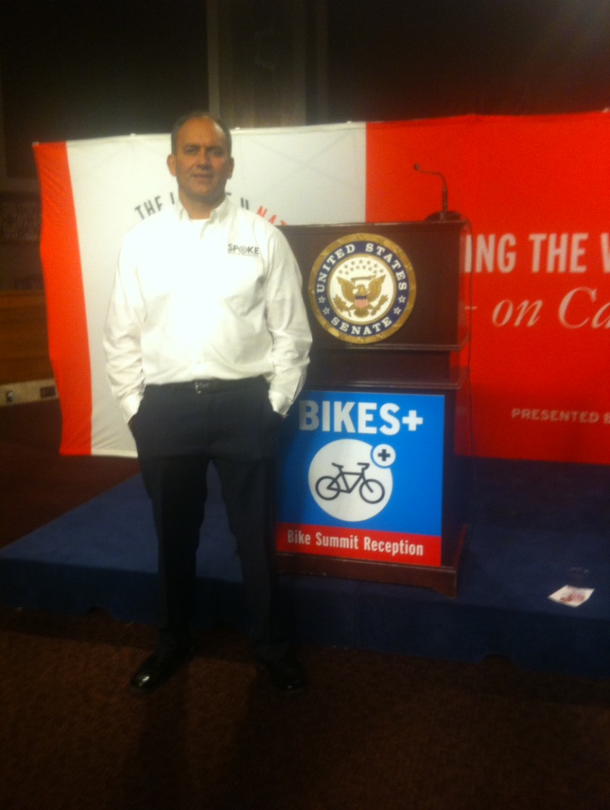
Spoke Founder
Founder of Sports Insurance Solutions
Triathlete
Ex Bicycle Courier
Bicycle commuter
Recreational rider

Slide 6
Retail President
21 Year Insurance Industry Veteran
Collegiate Cross Country/Track Athlete
Bicycle NUT!!!!!
Author of Several Economic Impact Studies-Economic Impact of Silent Sports Enthusiasts 21 Year Insurance Industry Veteran
Exclusively Work in Bicycle Industry Risk

Slide 7
Mission Statement
We are here to provide a direct line of coverage to cyclists by taking away the hurdles faced in securing primary insurance for riders and their bicycles.

Slide 8
What we cover and why.

Slide 9
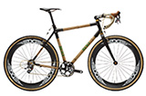
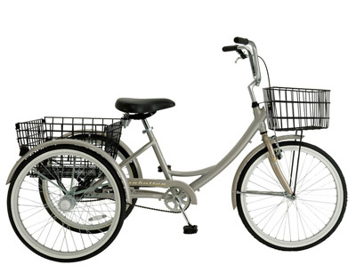
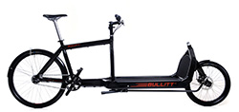
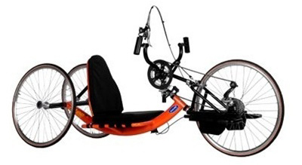
Bicycles we cover

Slide 10
Basic Policy Includes
Damage
Theft
Worldwide Damage
Rental Reimbursement
Roadside Assistance
Minimum Premium $100.00 per annum.

Slide 11
Optional Coverage
Liability
Motor Vehicle Contact Protection
Medical Payments

Slide 12
ooopps!!

Slide 13
Bicycle Damage Coverage
Bicycle Damage Insurance
We will cover sudden, accidental direct physical damage to the insured bicycle. We will pay the amount necessary to repair or replace the insured bicycle with like kind and quality less the deductible shown in the Declarations Page for “Physical Damage” LIMITS: Bicycle values up to $20,000

Slide 14
Really!!

Slide 15
Bicycle Theft Coverage
We will cover sudden, accidental direct physical loss to the insured bicycle with like kind and quality less the deductible. Theft from your residence or away from your residence. LIMITS: Bicycle values up to $20,000

Slide 16
Cyclists are liable.

Slide 17
Bicyclist Liability Insurance
We will pay on behalf of the insured damages for bodily injury or property damage for which an insured becomes legally liable through ownership, maintenance, use, loading or unloading of an insured bicycle. LIMITS: $25,000 , $50,000 , $100,000, $300,000

Slide 18
Ouch!!

Slide 19
Medical Payments
We will cover the reasonable charges for necessary medical, surgical, x-ray, dental, ambulance, hospital and professional nursing services and funeral service expenses incurred within one year from the date of an accident causing bodily injury to an insured while operating or occupying an insured bicycle. Medical payments coverage is excess over any other collectible insurance providing payments for medical or funeral expenses. LIMITS: $1,000 , $2,500 , $5,000 , $7,500 ,$10,000 , $15,000, $20,000, $25,000

Slide 21
Motor Vehicle Contact Protection
We will pay those sums the insured is legally entitled, but unable, to recover as damages for bodily injury from the owner or operator of an uninsured/underinsured motor vehicle as a result of physical contact between the insured bicycle and the uninsured/underinsured motor vehicle. LIMITS: $10,000 , $25,000

Slide 22
Not again!!

Slide 23
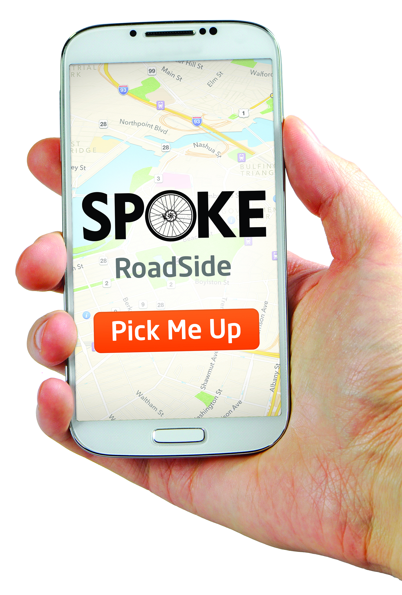
Bicycle Roadside Assistance
10,500 Tow operations across America
3 x 50 mile pick ups each year
Free partner tow
$50.00 locked bike reimbursement
$50.00 tow reimbursement if we for any reason cannot pick you up.
SPOKE roadside app.
Geo tracking technology to locate stranded riders

Slide 24
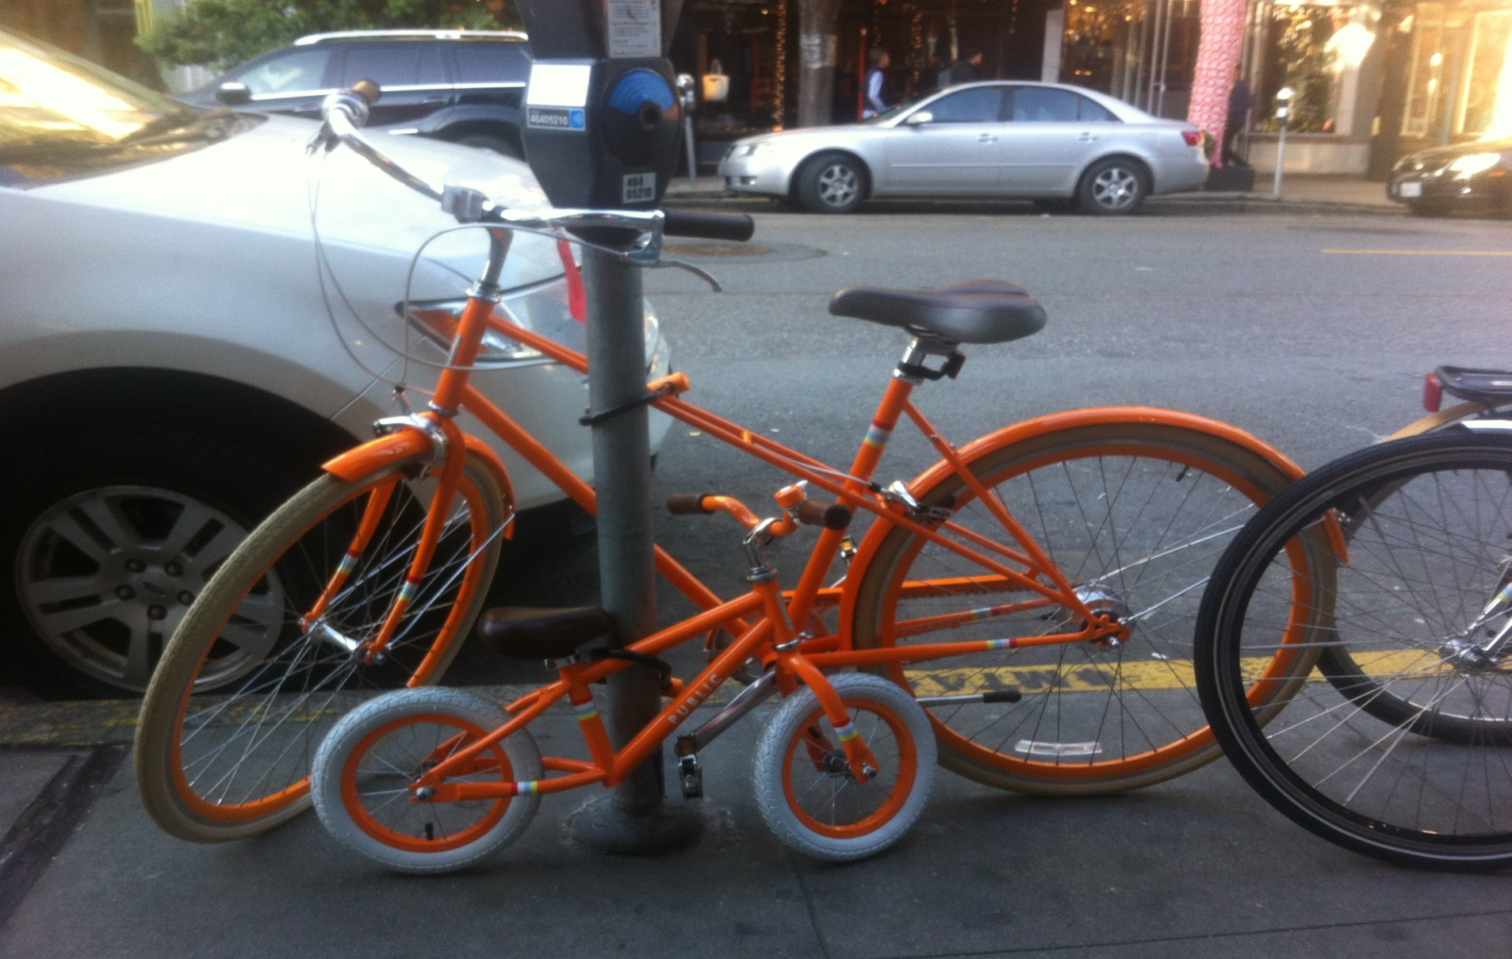
Smart!

Slide 25
Not so smart.

Slide 26
WHY SPOKE?
National Program supported by some of the largest and most reputable insurance providers in the USA
Financial Strength A for Excellence Am Best
Dedicated Claims Hotline
Bicycle Industry expertise in bicycle Shop Insurance and bicycle manufacturing insurance

Slide 27
Strategic Partner to the League of American Bicyclists and their efforts to bring awareness to the many concerns that face the bicycling public.

Slide 28
Contact US
Customer Service: 1-866-954-1025
Claims: 1-855-712-7212
Website : https://www.spokeinsurance.com/
info@spokeinsurance.com
daws@sports-insurance-solutions.com

