Slide 1
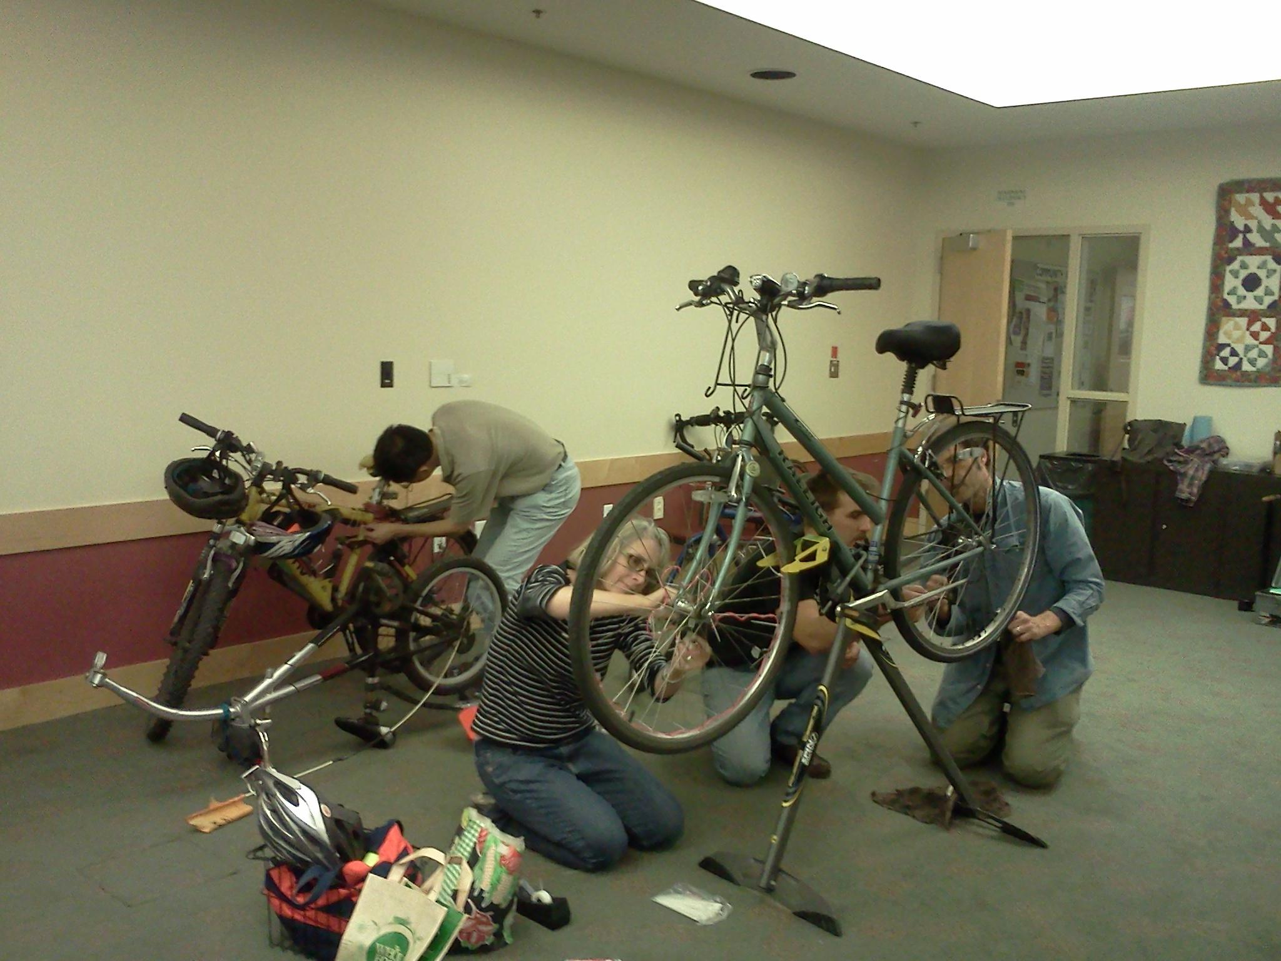
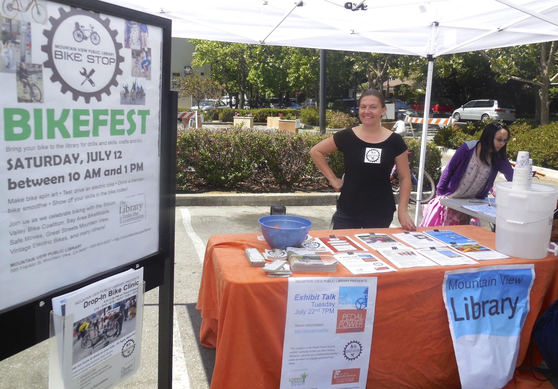
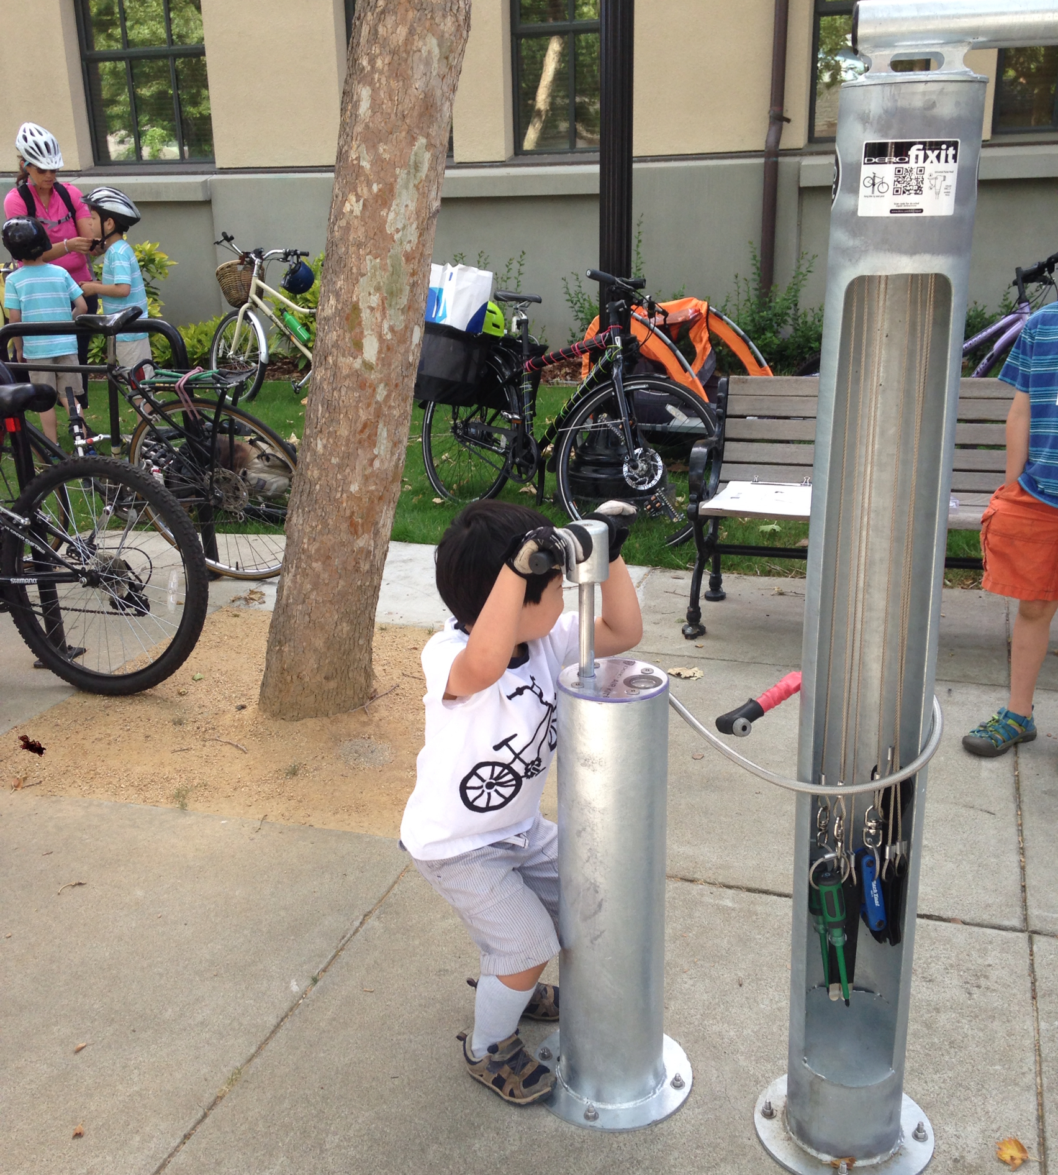
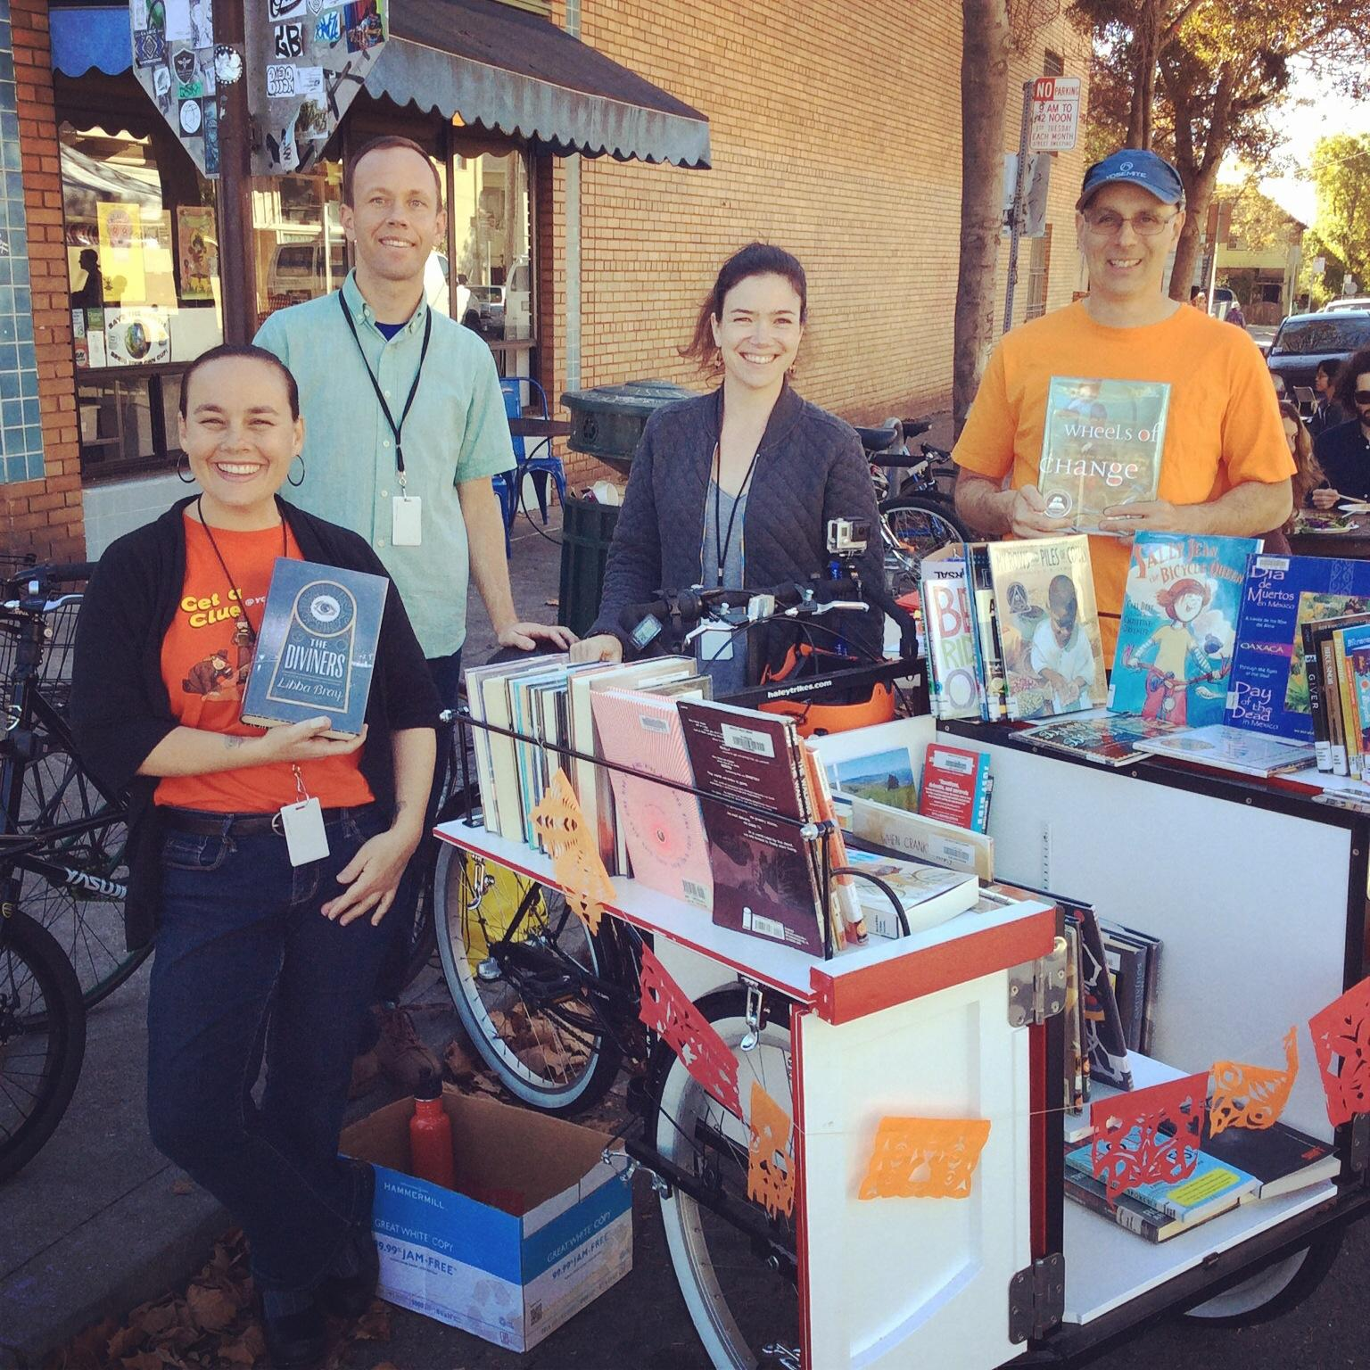
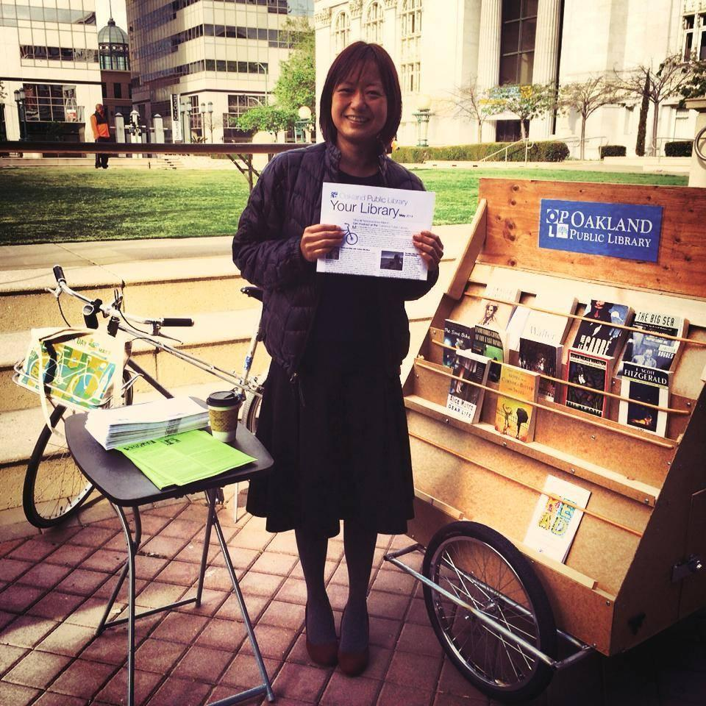
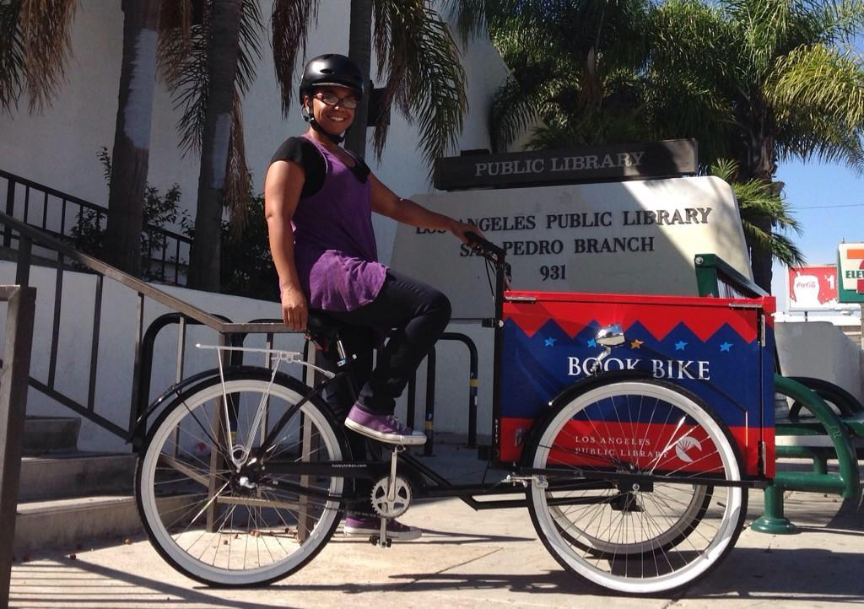
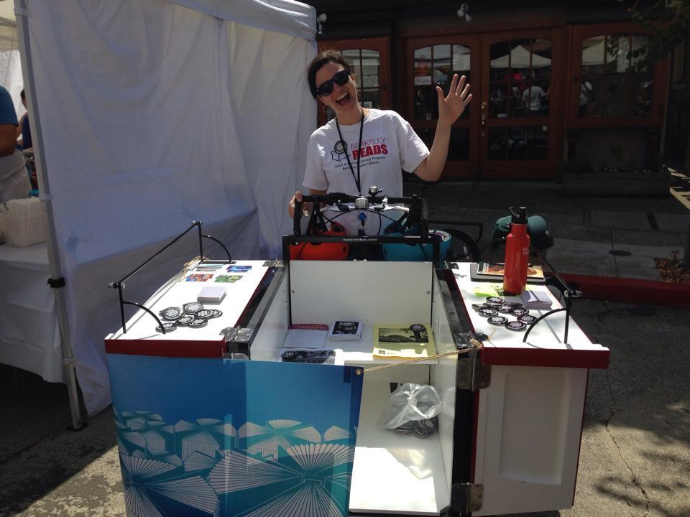
Bikes + Libraries

Slide 2
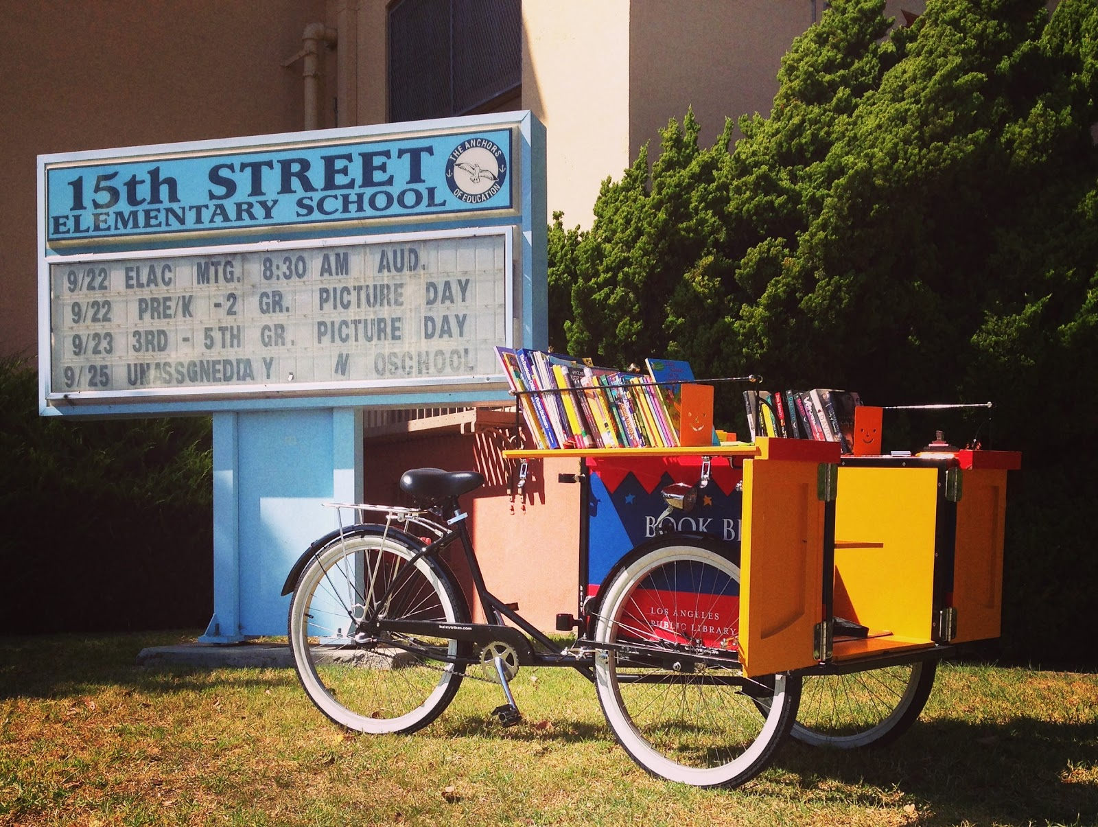
Bikes and Libraries have a lot in common.

Slide 3
Here are some of the things libraries are doing to support bicycling and bicyclists in their communities.

Slide 4
Book Bikes
Berkeley Public Library
Boston Public Library
Cambridge Book Bike*
Chicago Book Bike*/Bibliotreka
Cleveland Heights Public Library
Denver Public Library
Evanston Public Library
Laurence Copel (Lower 9th Ward, New Orleans)*
Los Angeles Public Library
Maricopa County Public Library
Oakland Public Library
Omaha Public Library
Pima County Public Library
Richland County Public Library
San Francisco Public Library (Coming in May)
Seattle Public Library
Street Books (Portland, Oregon)*

Slide 5
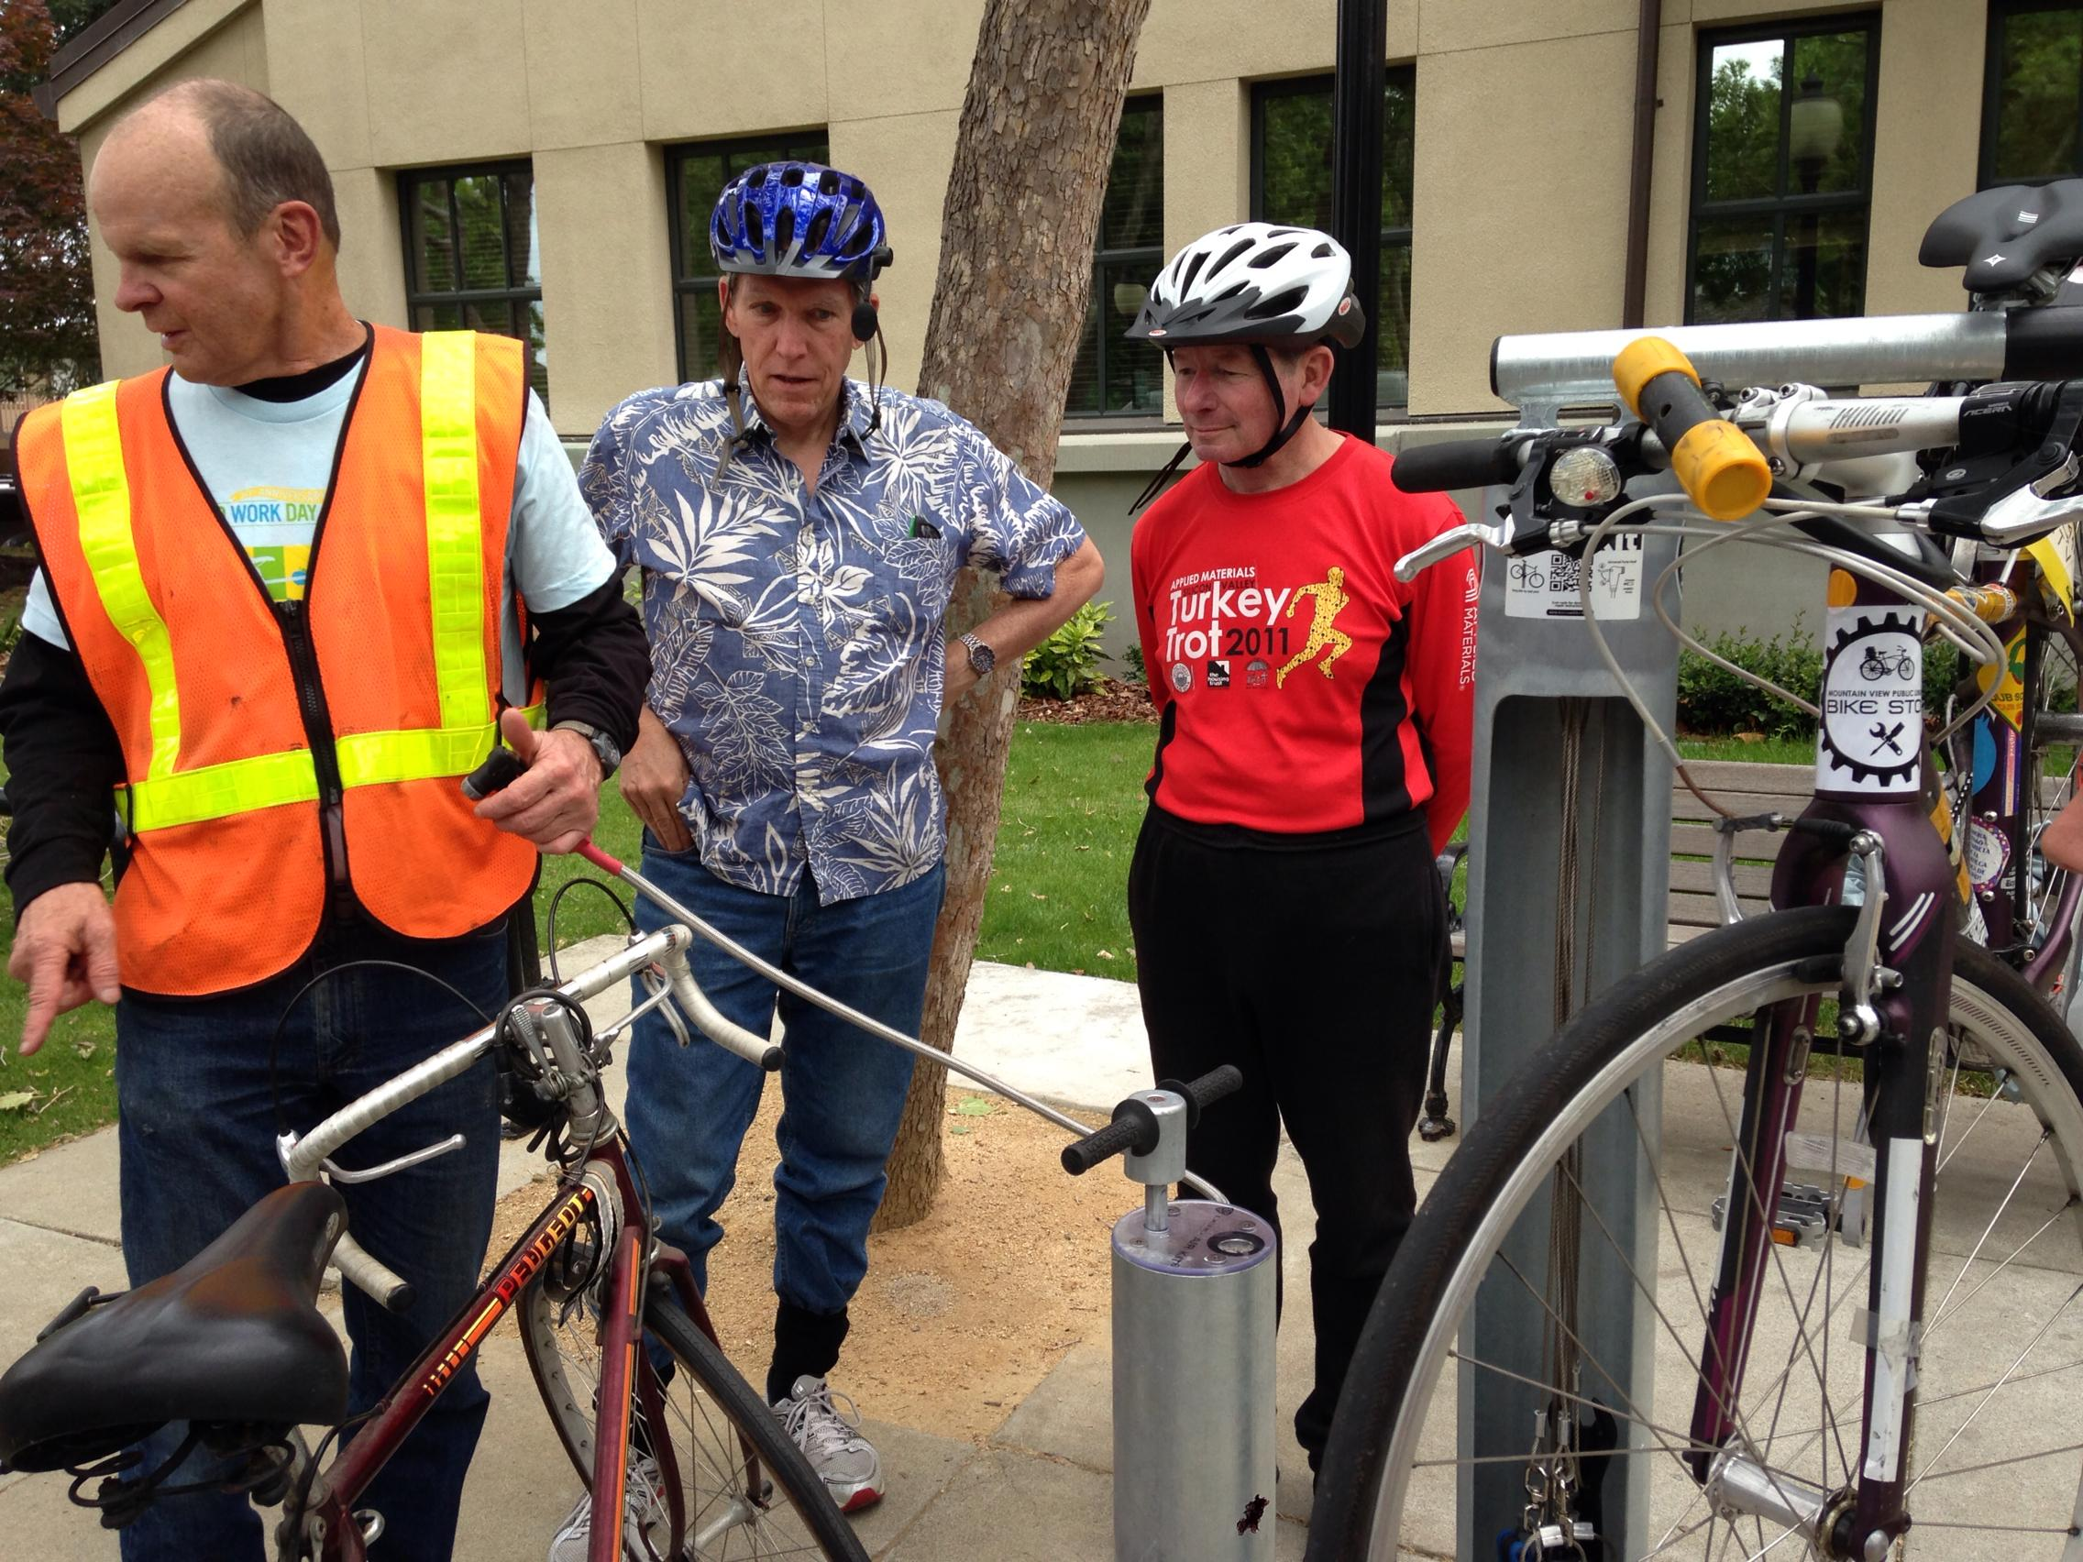
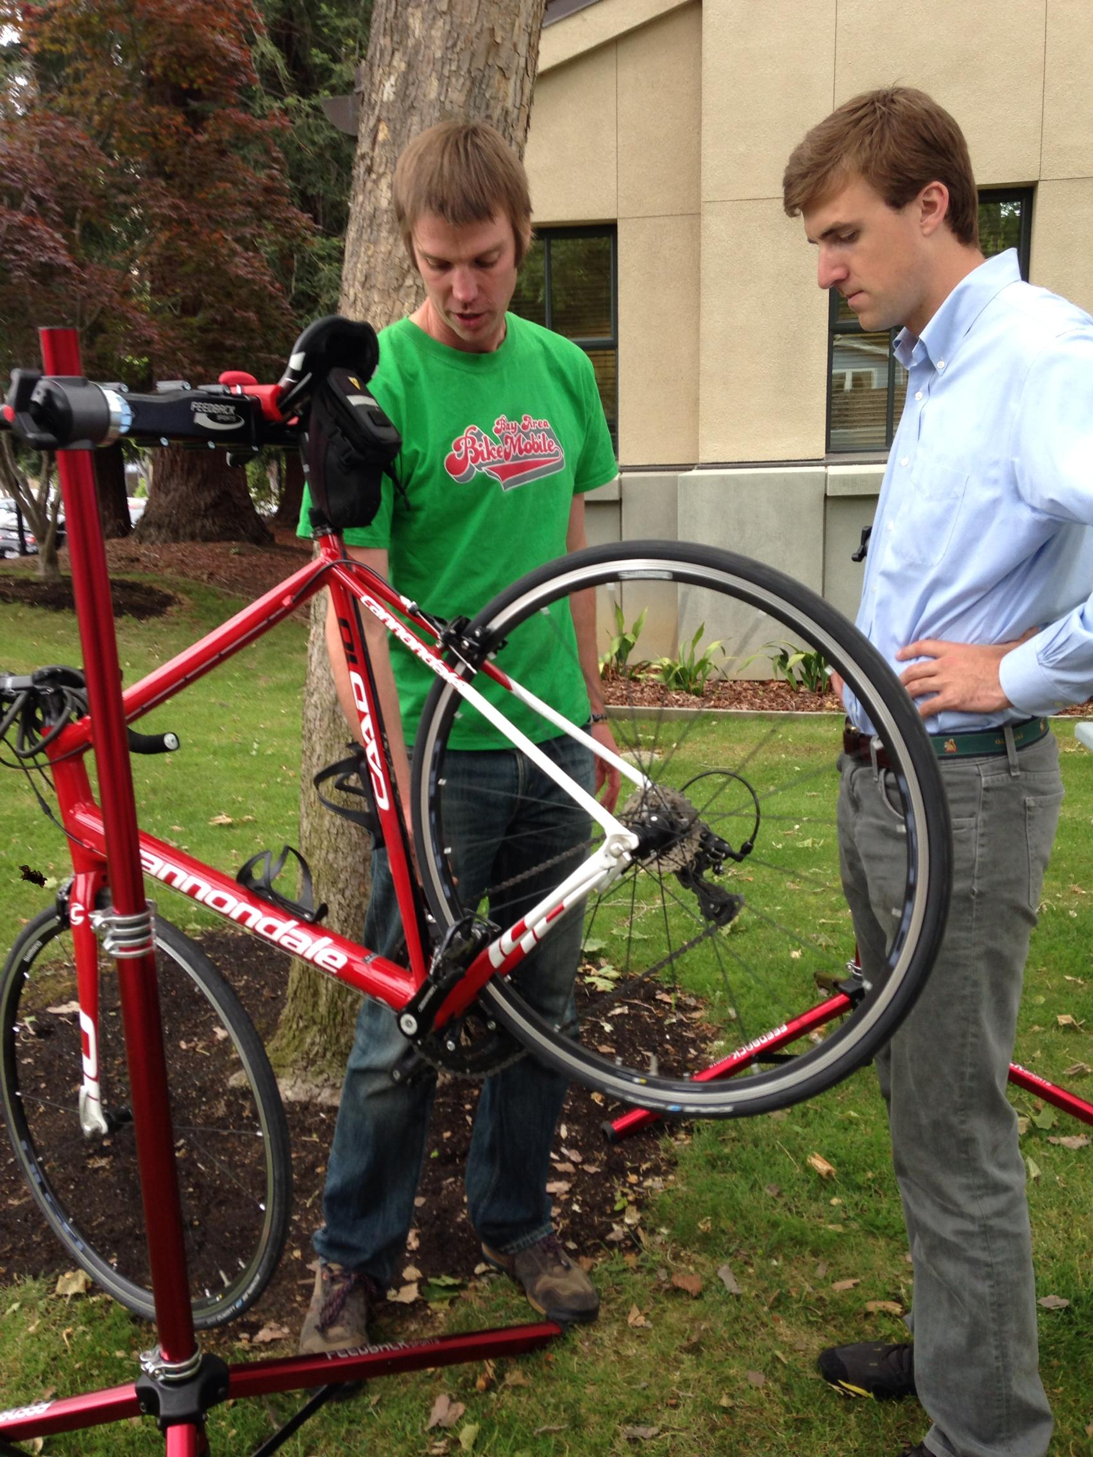
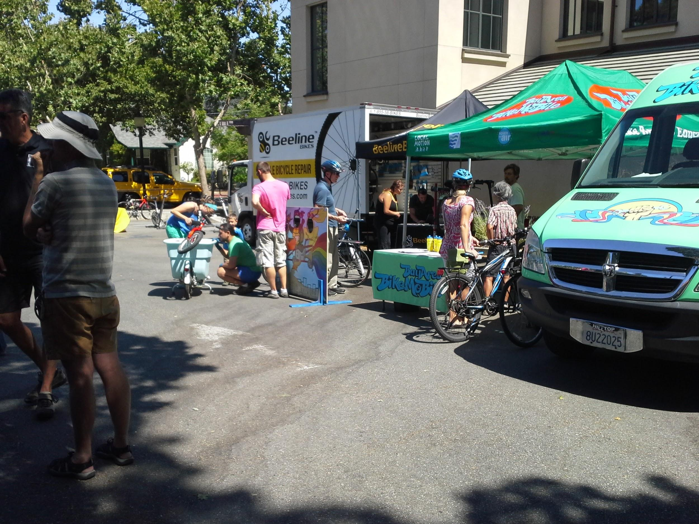
Repair Clinics

Slide 6
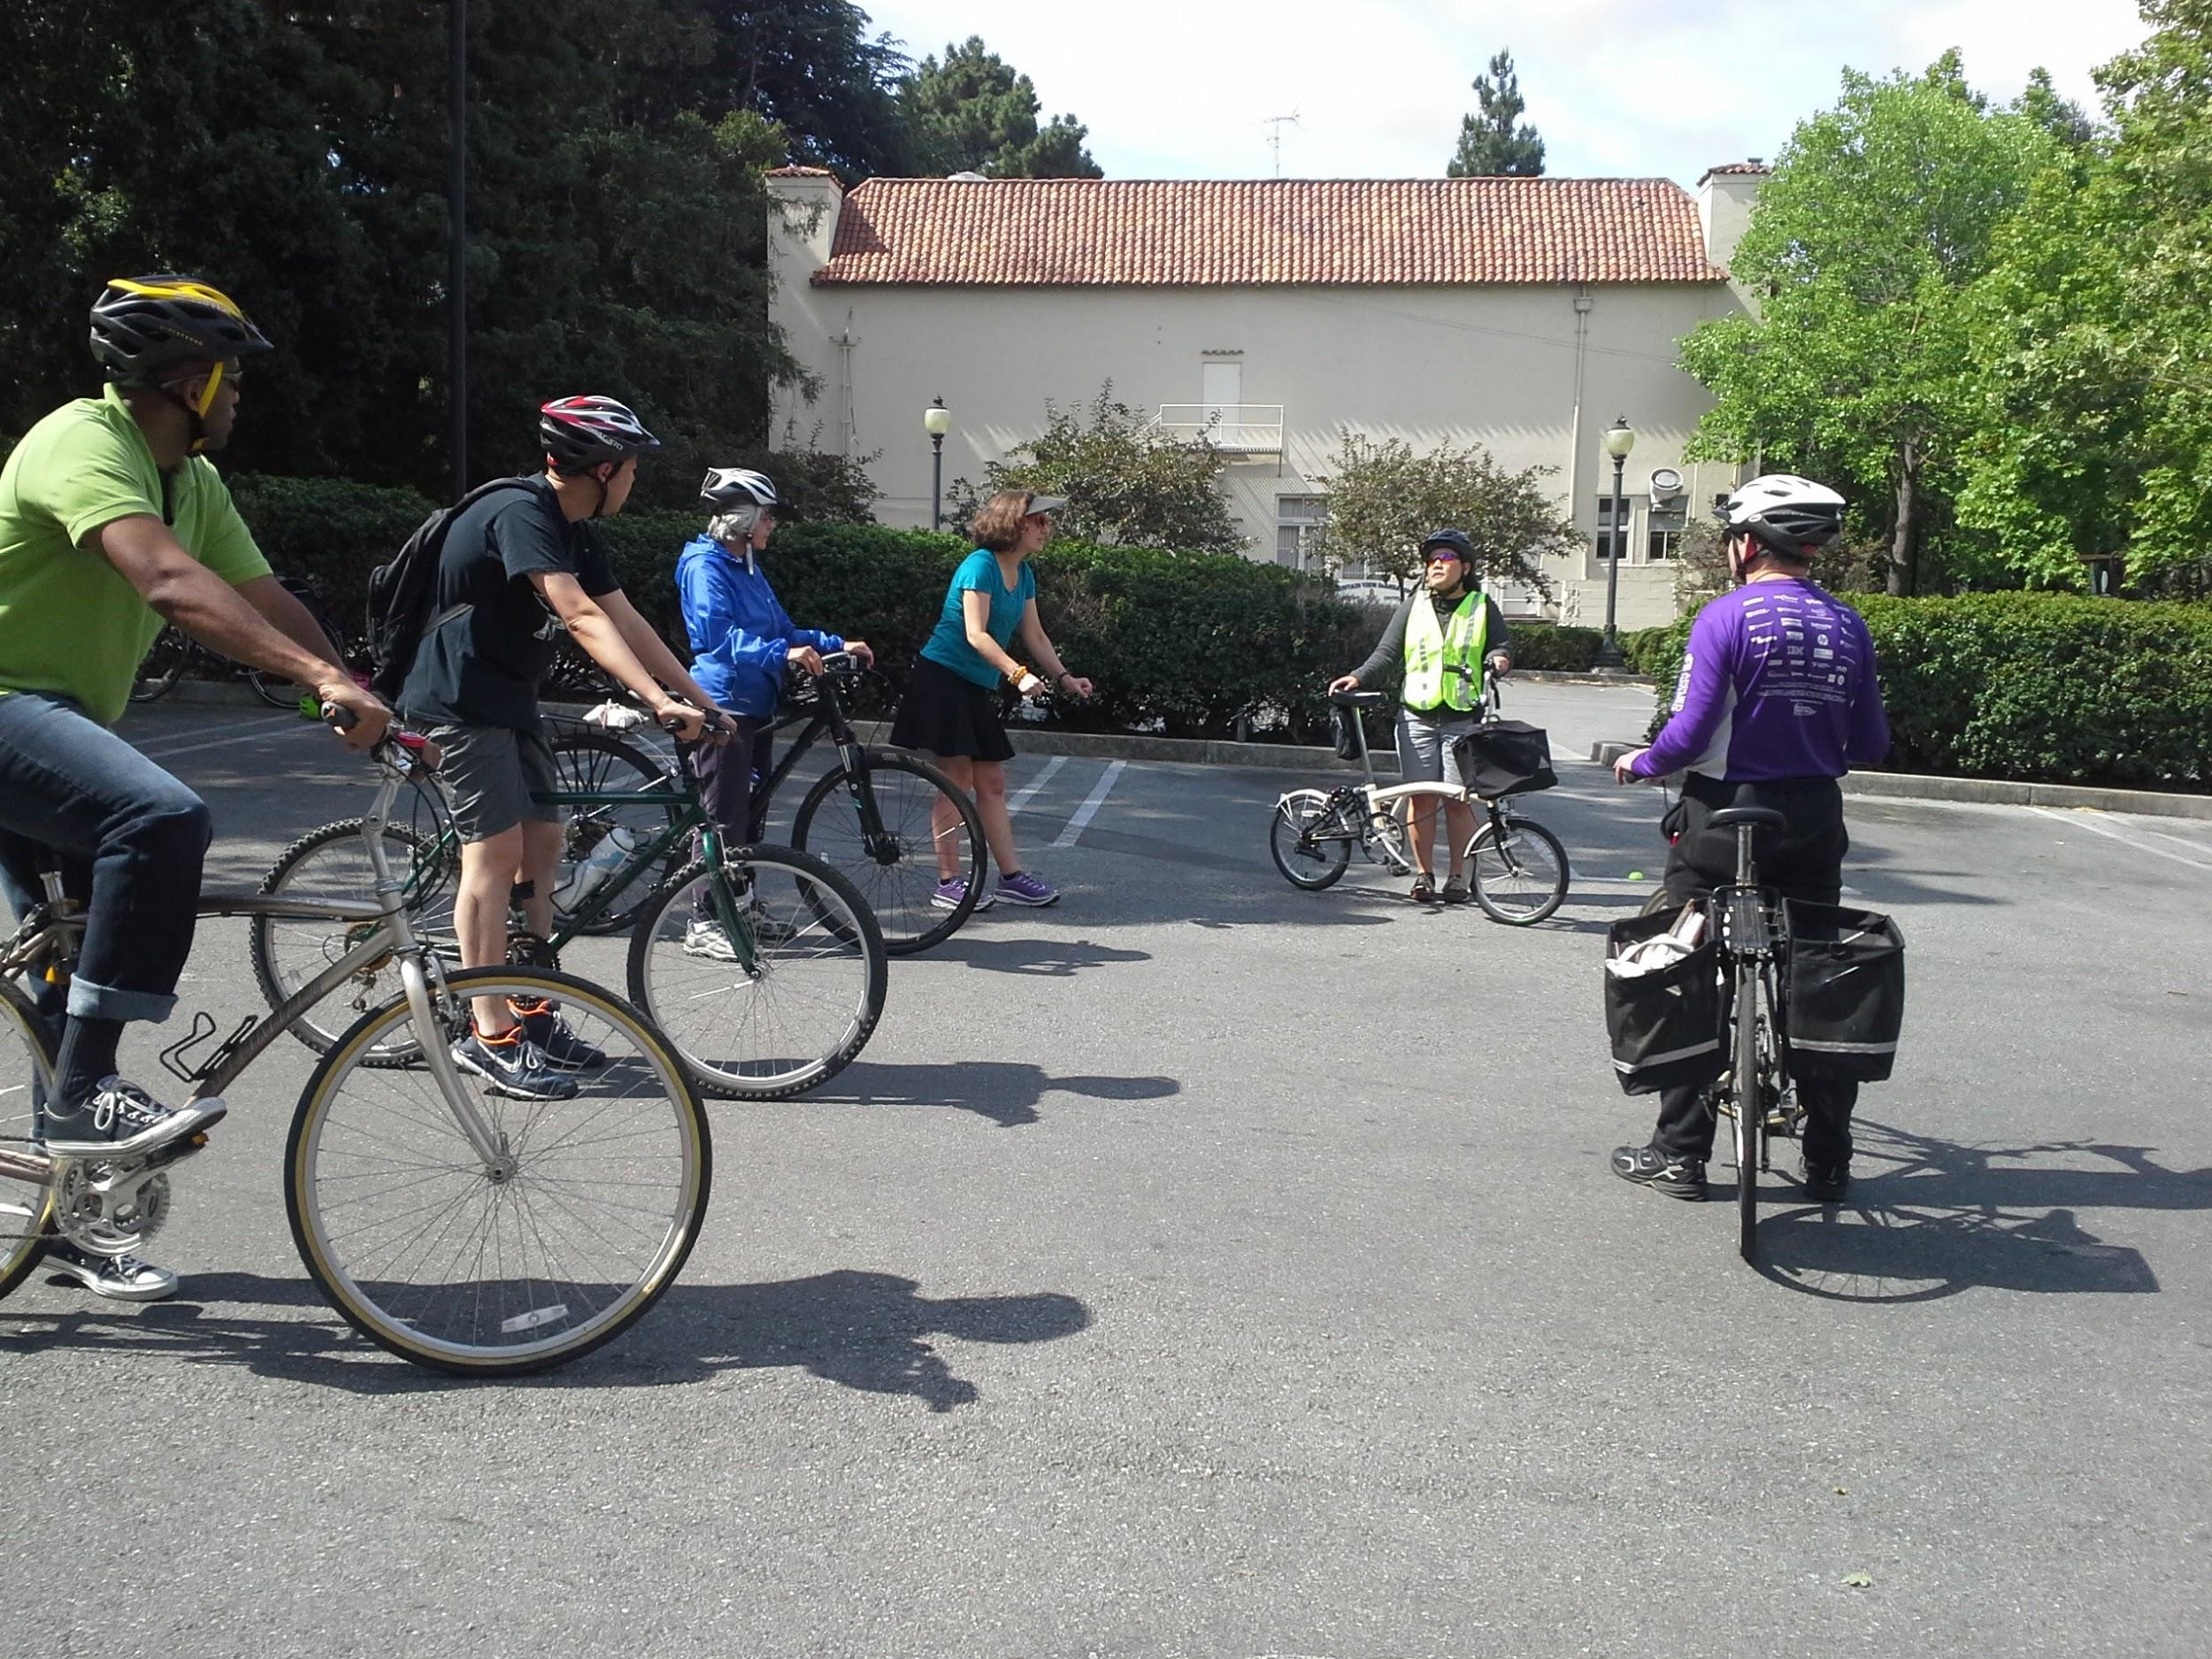
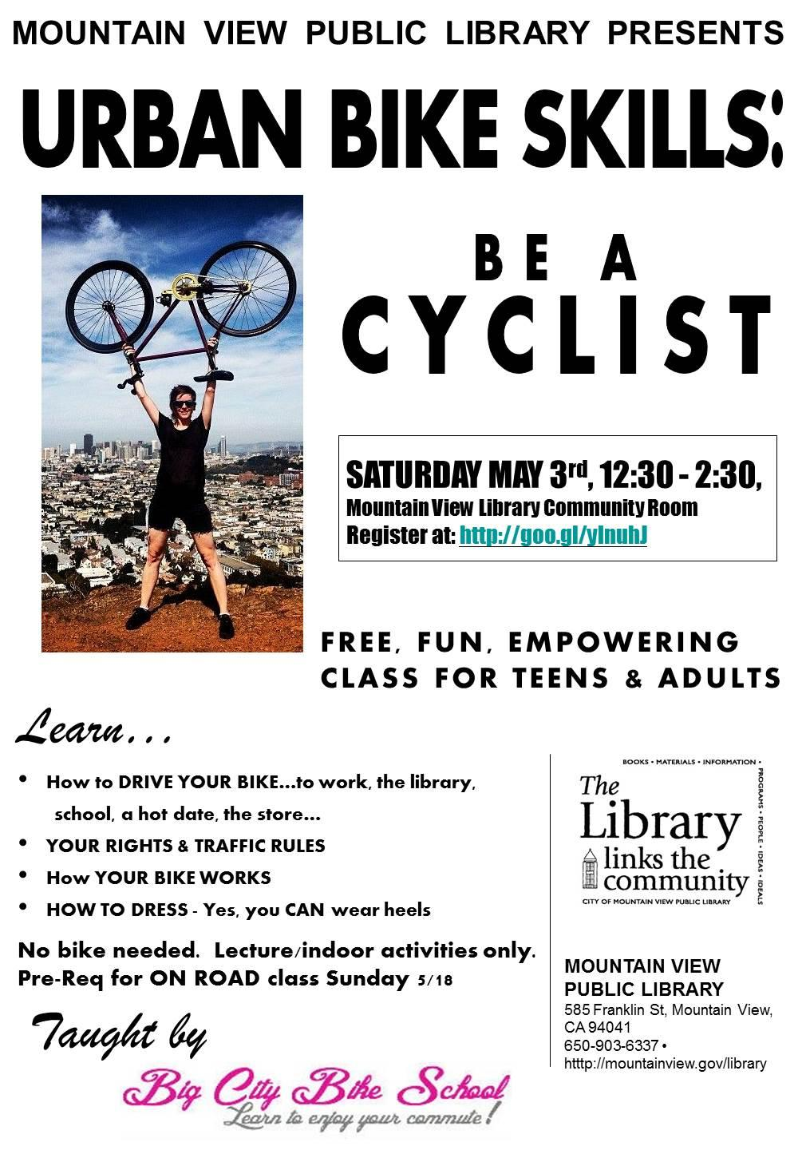
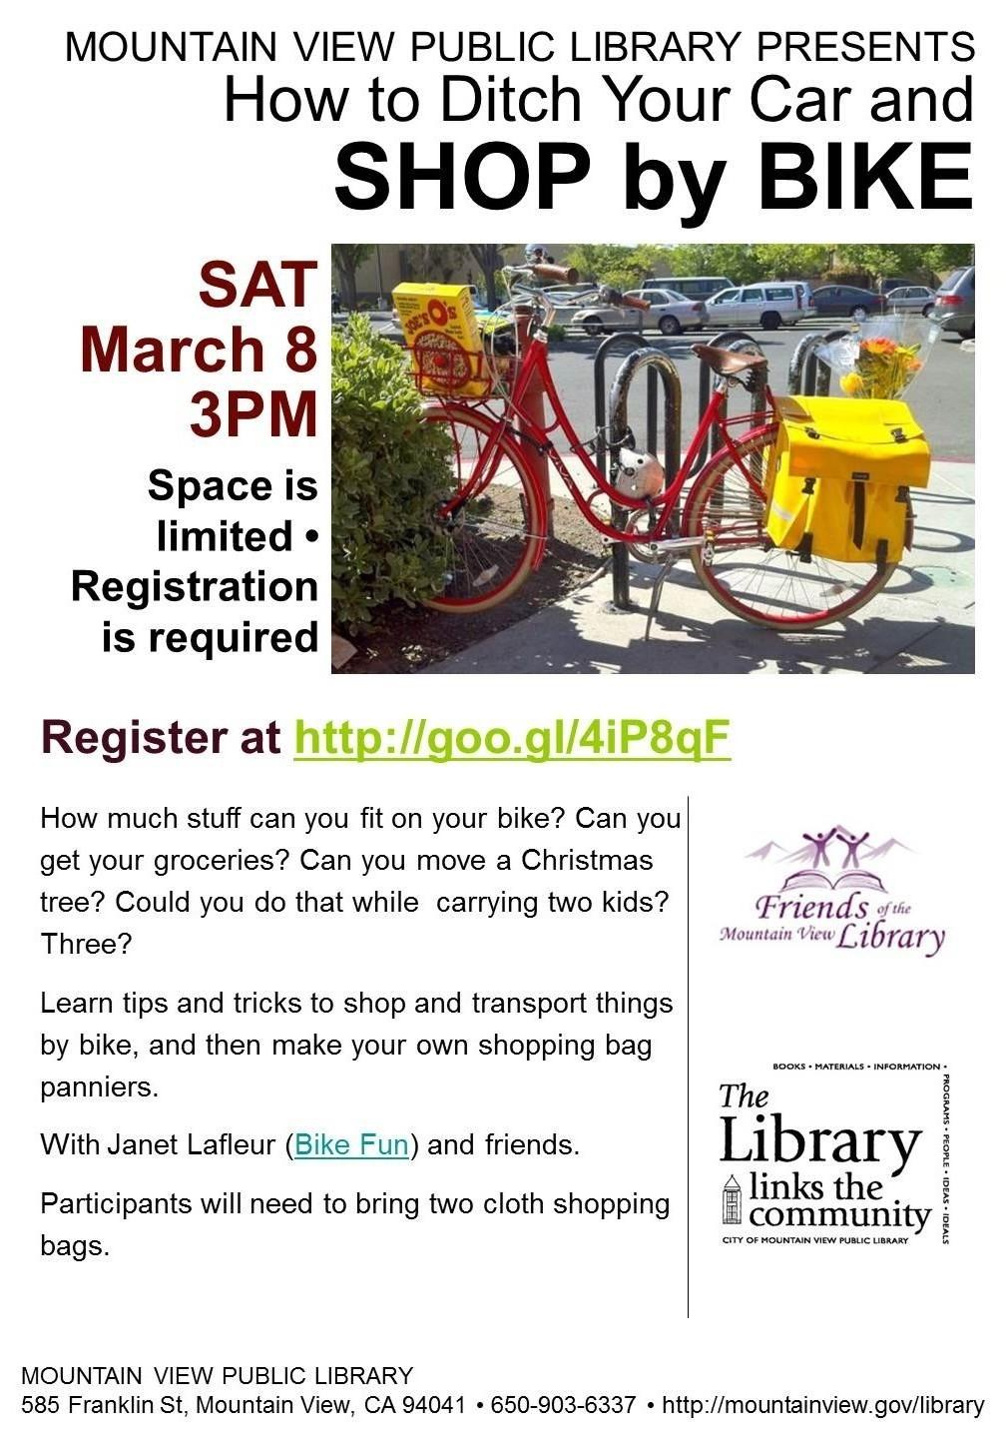
Bike Skills

Slide 7
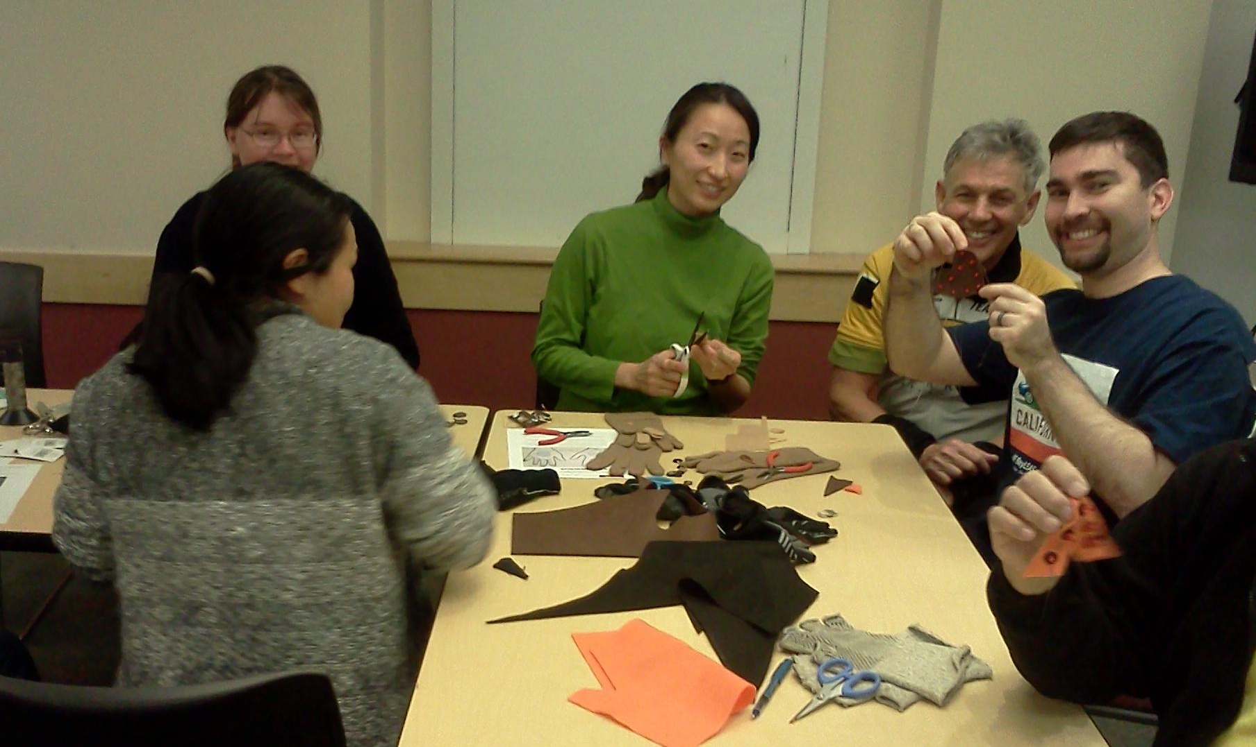
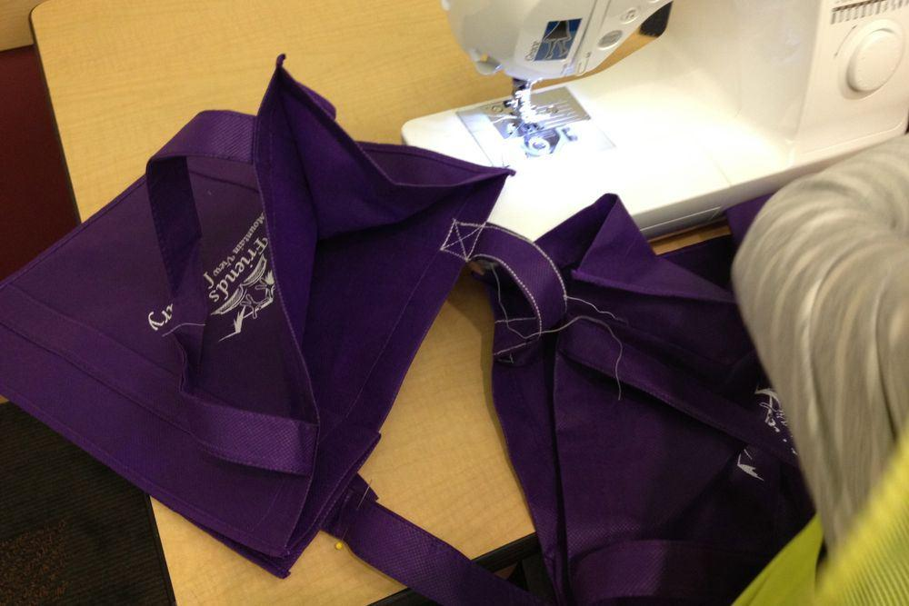
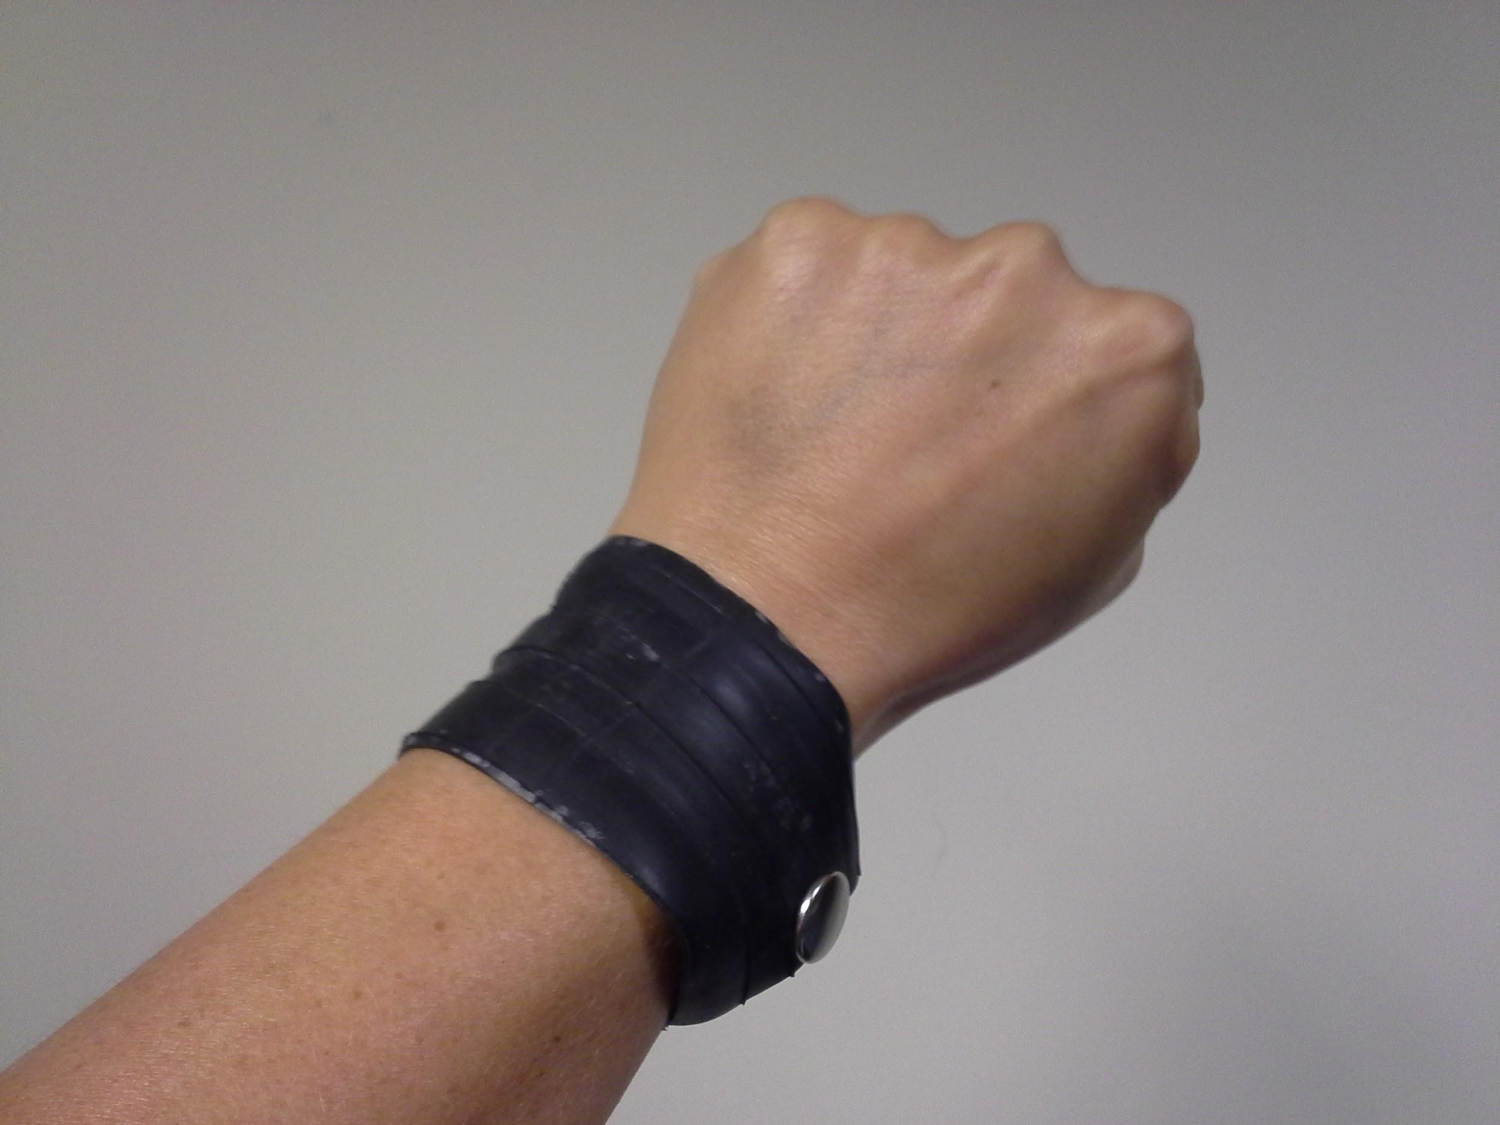
Maker Bike/
Crafty Bike
Notes:
Turn Signal Glove (Sewable circuits), Book bag Panniers, Inner Tube Bracelet, EL Wire Light Design

Slide 8
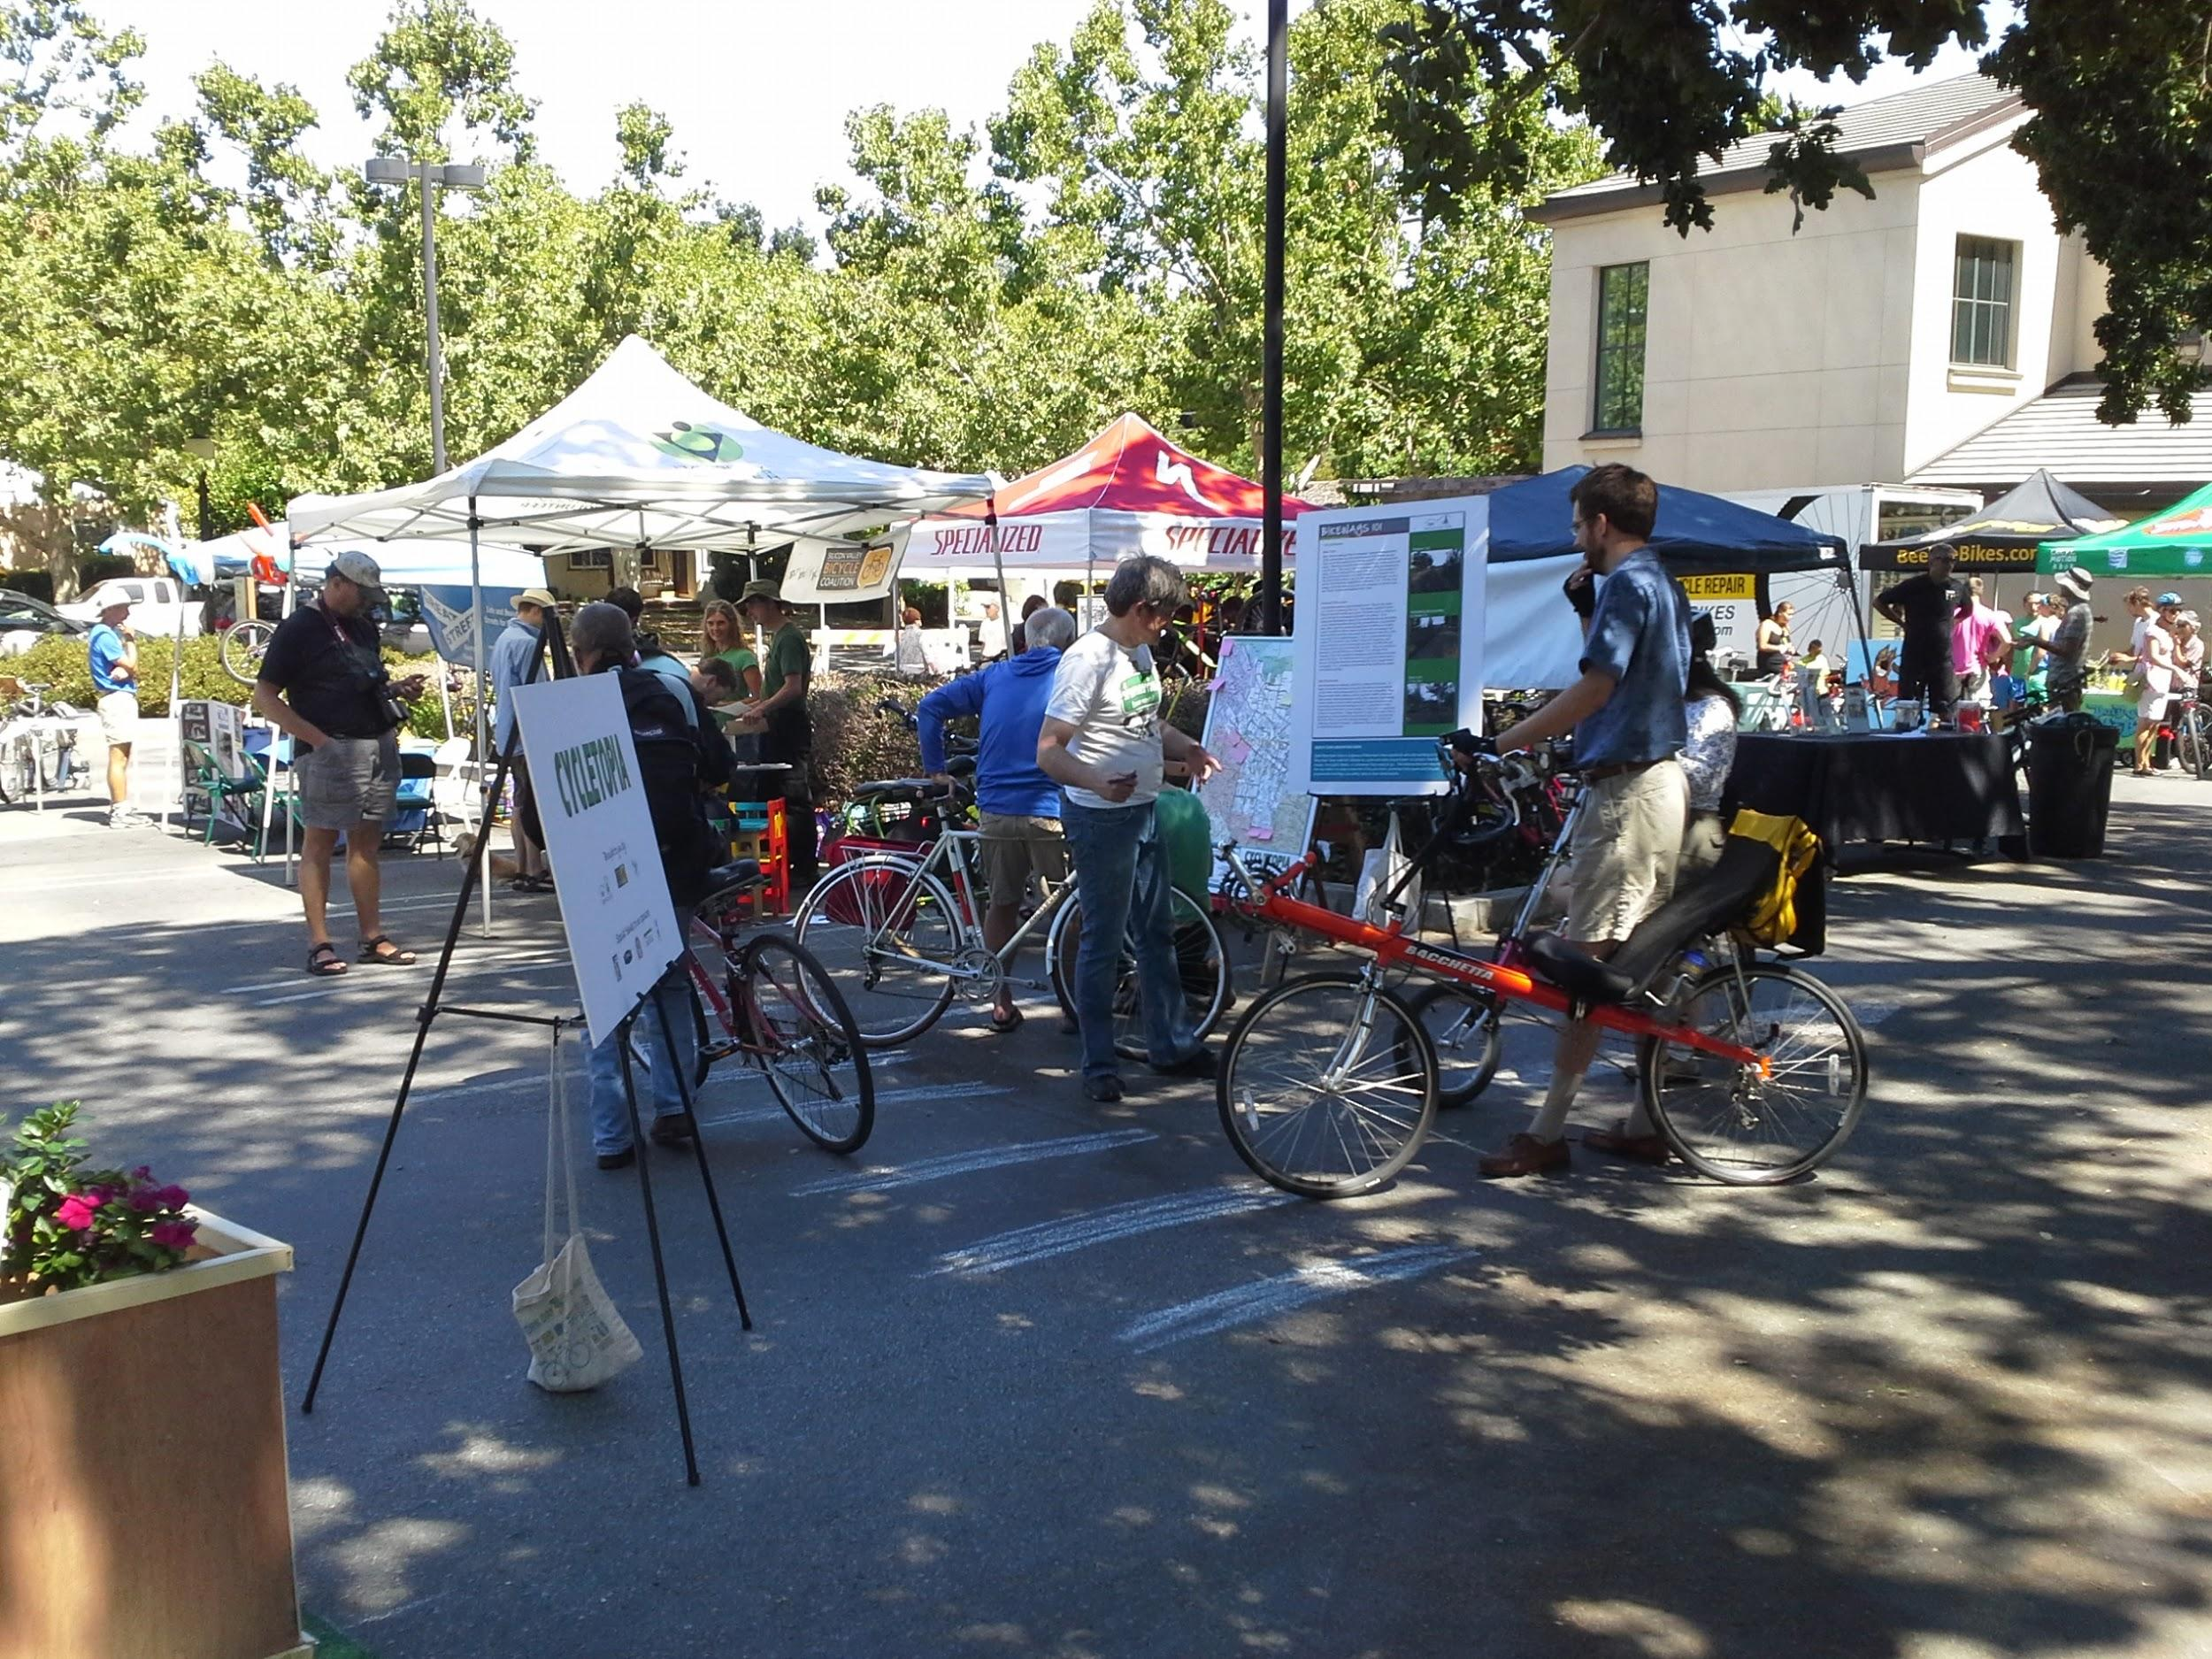
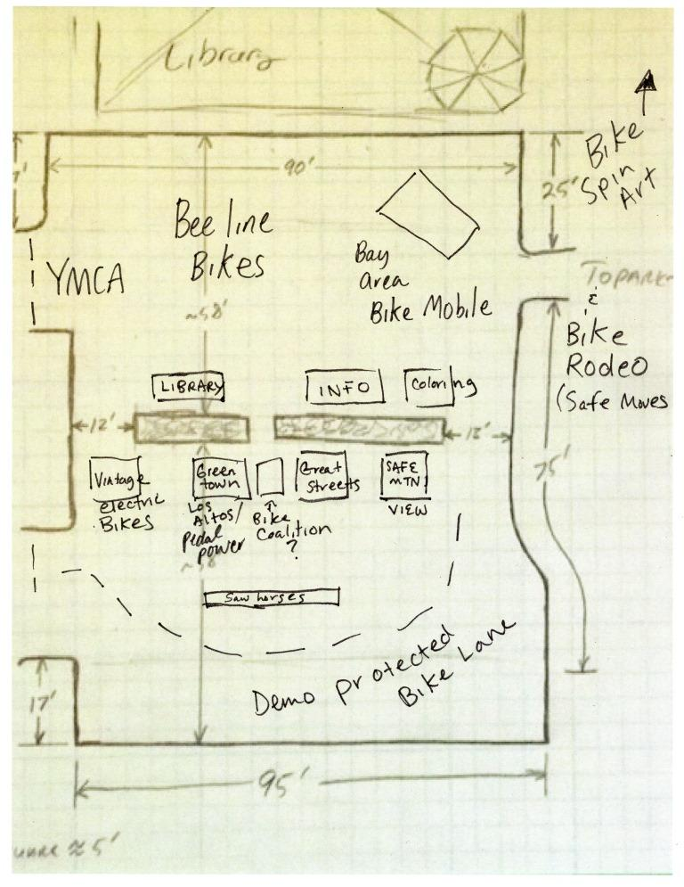
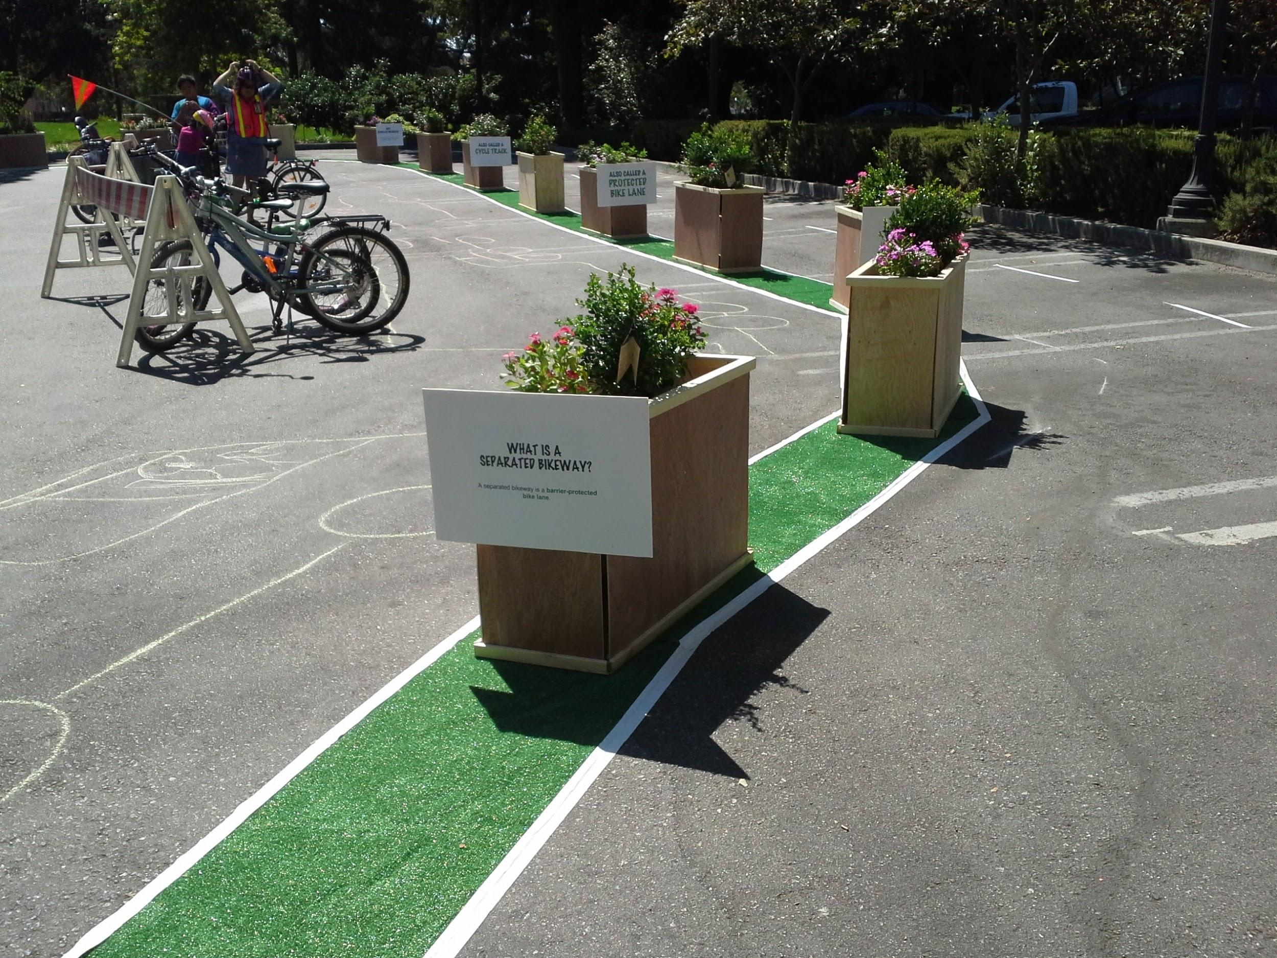
BIKEFEST

Slide 9
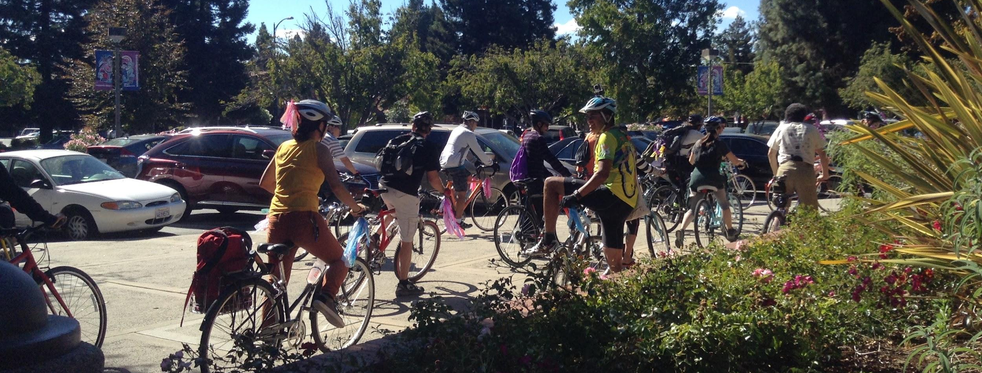
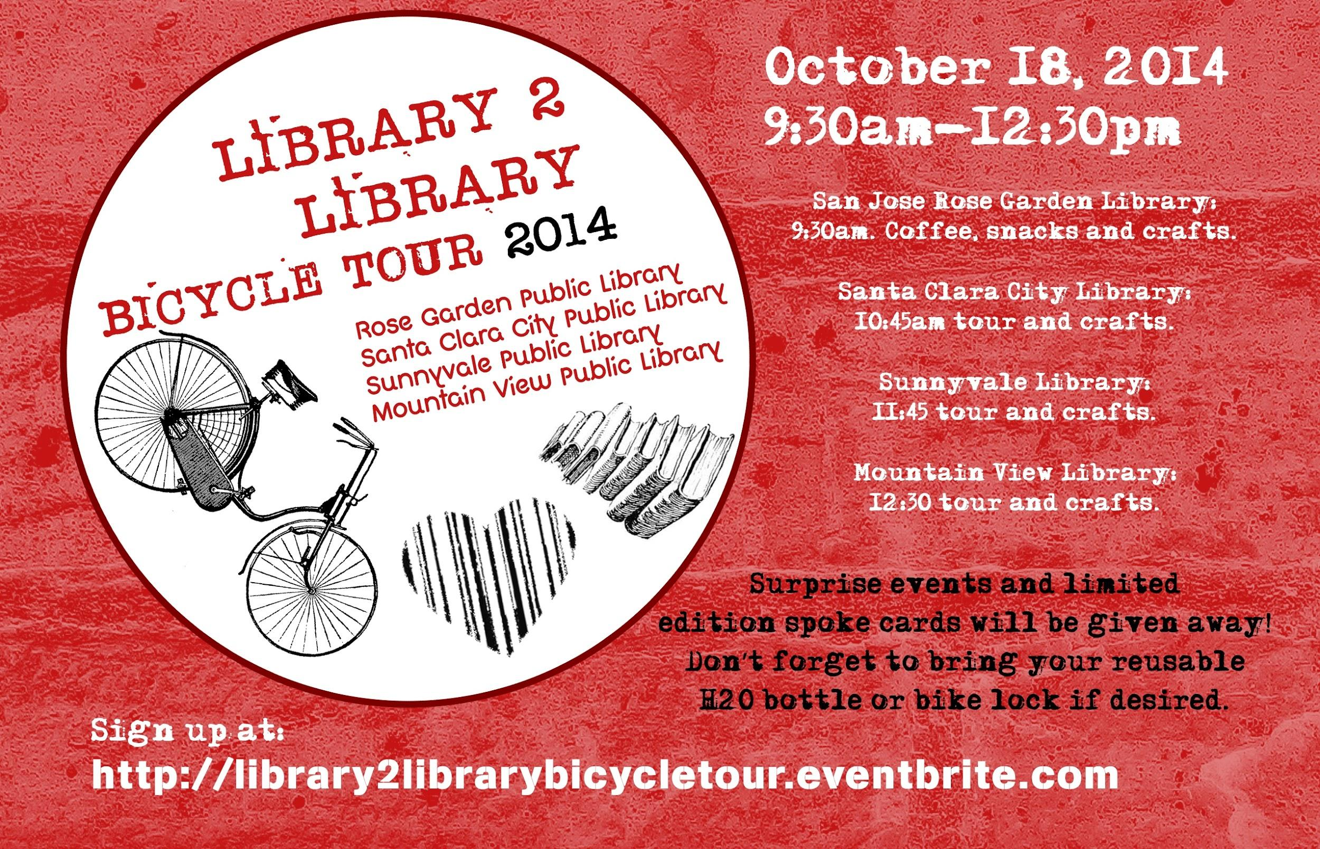
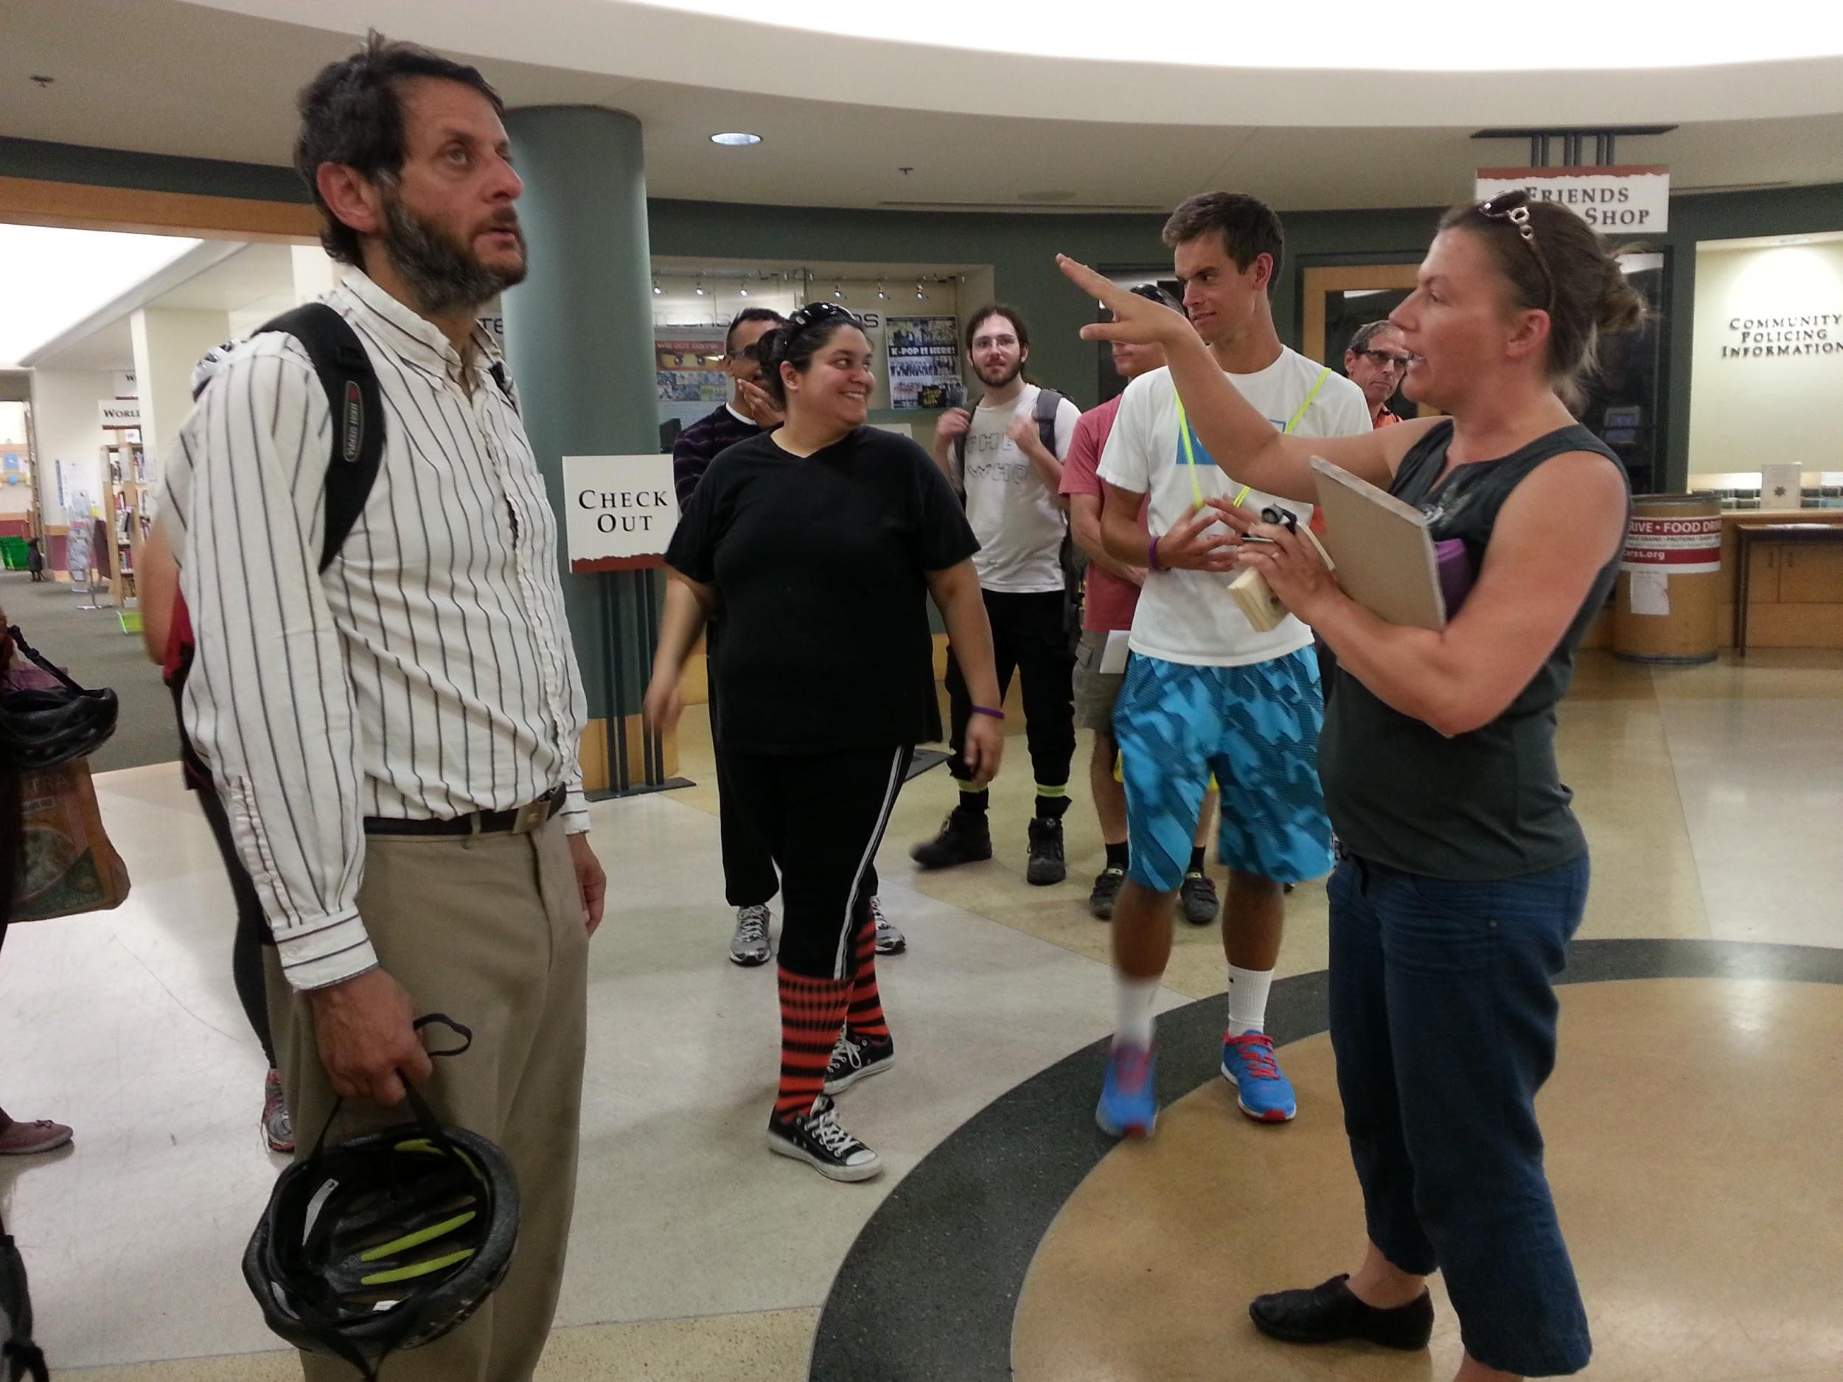
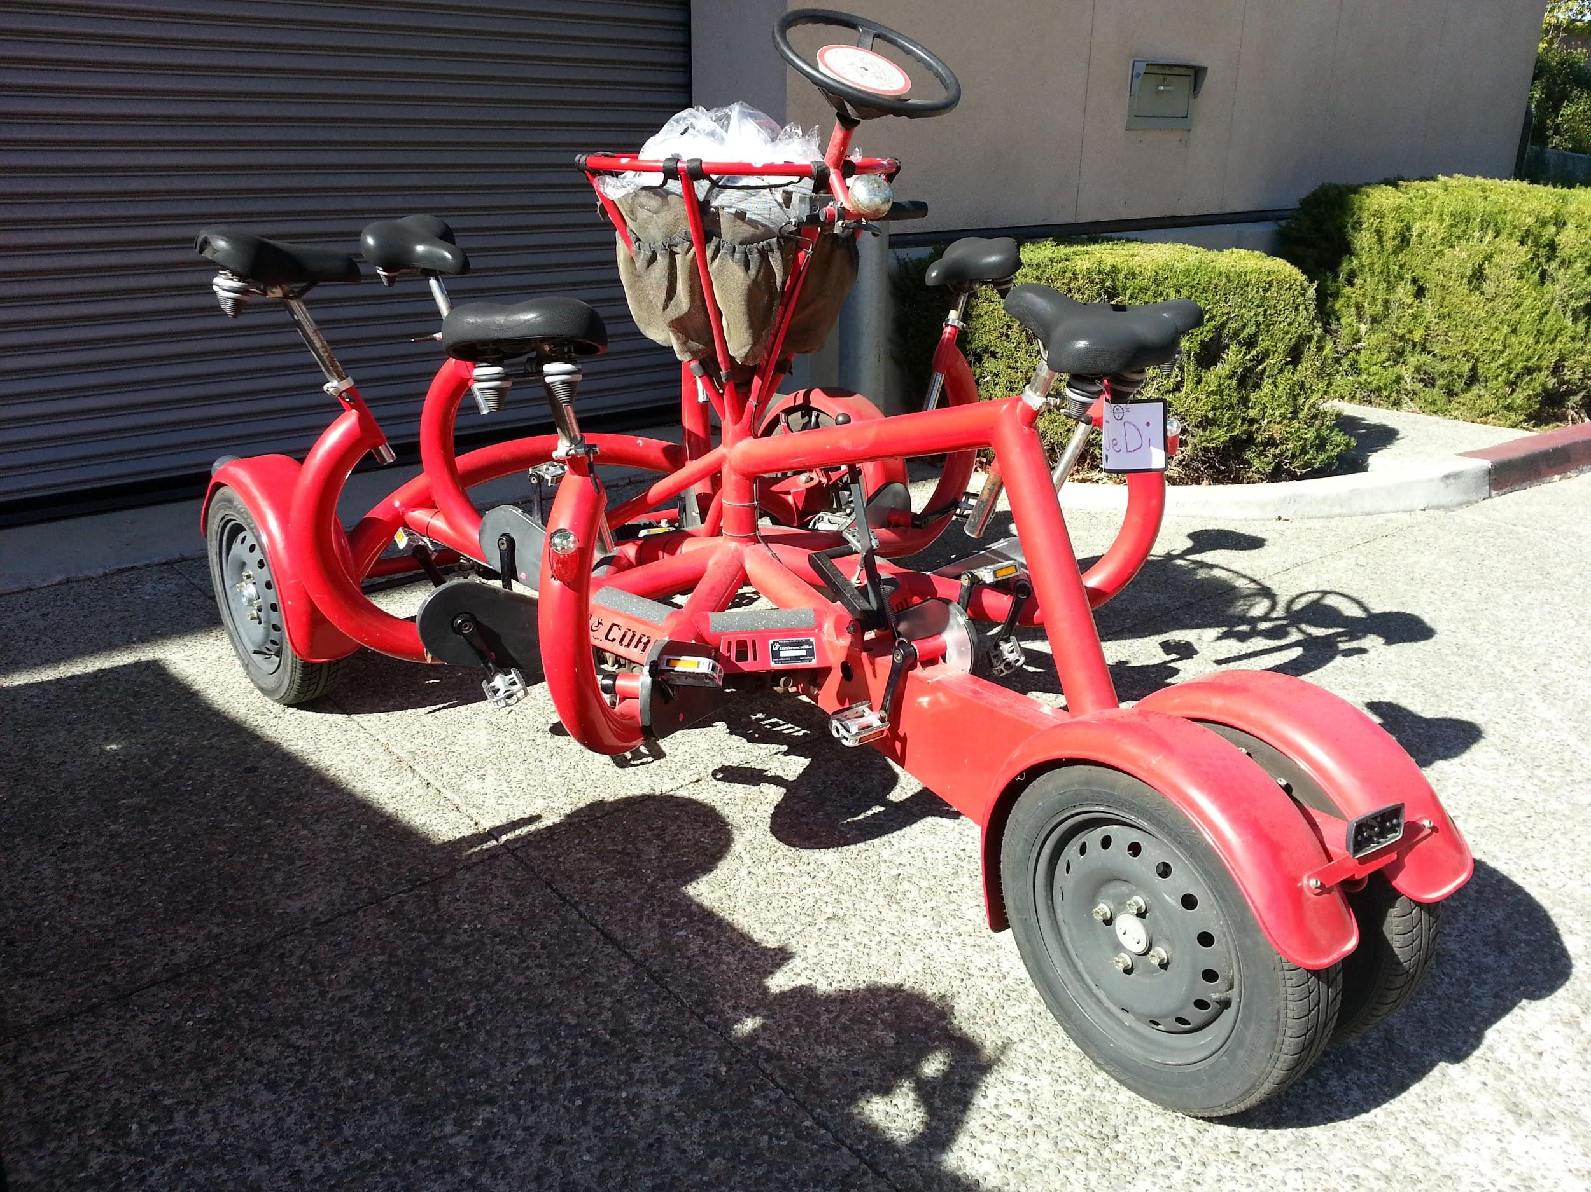

Slide 10
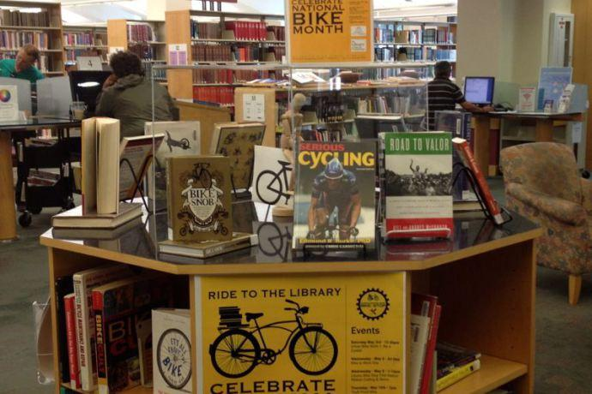
Books about Bikes
Notes:
https://encore.mountainview.gov/iii/encore/search/C__Sbike%20month%202014__Ff%3Afacetfields%3Acommunitytag%3Acommunitytag%3ACommunity%20Tag%3A%3A__Orightresult__U__X0?lang=eng&suite=cobalt

Slide 11
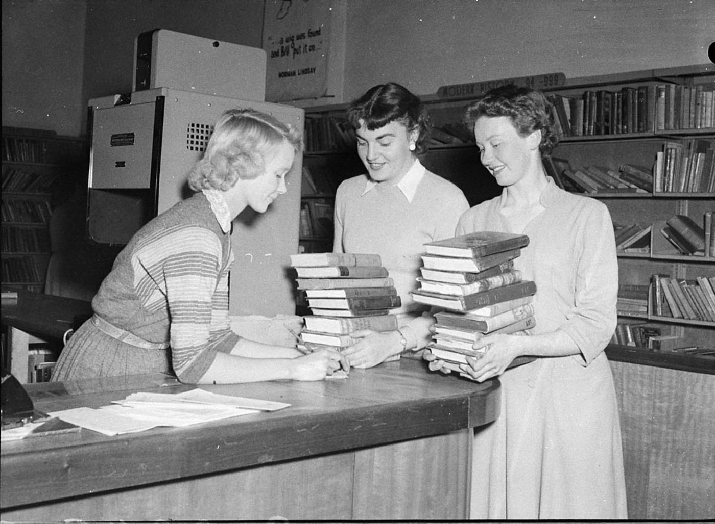
Let me give you a few reasons why you want to work with libraries.

Slide 12
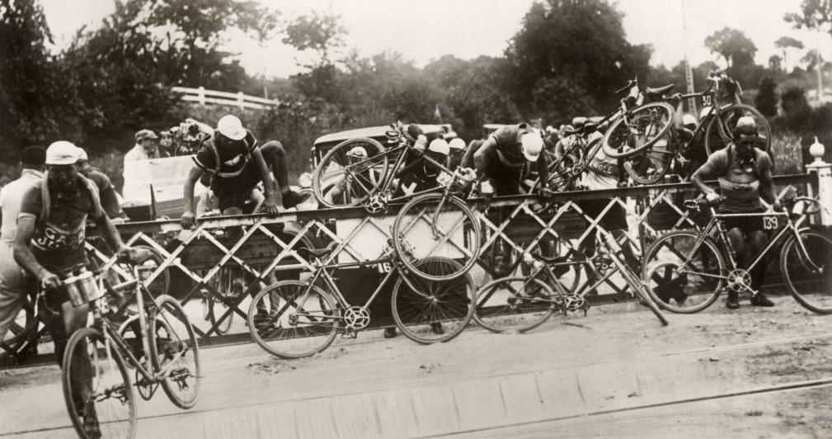
I have some tips on getting your wheel in the door, at the library.

Slide 13
Contact: Emily Weak, Librarian Mountain View Public Library (California) emily.weak@mountainview.gov

